Slide 1
Sarcopenia is Associated With Development of Acute-on-Chronic Liver Failure in Decompensated Liver Cirrhosis Receiving Transjugular Intrahepatic Portosystemic Shunt
Journal Club - 27.06.2019
Praktiknjo M¹, Clees C¹, Pigliacelli A², Fischer S³, Jansen C¹, Lehmann J¹, Pohlmann A¹, Lattanzi B², Krabbe VK¹, Strassburg CP¹, Arroyo V⁴, Merli M², Meyer C³, Trebicka J^{1,5}
1 Department of Internal Medicine I, University of Bonn, Bonn, Germany.
2 Department of Clinical Medicine, Sapienza University of Rome, Rome, Italy.
3 Department of Radiology, University of Bonn, Bonn, Germany.
4 European Foundation for the Study of Chronic Liver Failure-EF CLIF, Barcelona, Spain.
5 Department of Internal Medicine I, Goethe University Clinic Frankfurt, Frankfurt, Germany
Presenter: Ioannis Petridis, MD, PhD
Gastarzt

Slide 2
Introduction
Nutritional status represents a prognostic predictor of clinical outcome in patients with chronic liver disease
Muscle waisting or sarcopenia (pathological muscle loss) is a picture that we frequently observe in liver cirrhosis, is an obective feature of chronic protein malnutrition and is associated with increased morbidity and mortality before and after LTx.
Different methods using Cross sectional imaging are proposed for evaluation of sarcopenia.
Special software for analysis required, are time consuming and difficult to implement in clinical practise
Trasversal Psoas Muscle Thickness normalized by height (TPMT/height) measurement is considered simple and fast method

Slide 3
Introduction
Several studies demonstrated that TPMT/height is an indipendent predictor of mortality in cirrhotic patients on the waiting list for LTx
TPMT/height is influenced by different factors (gender)
In addition, pt with cirrhosis and acute decomensation (ADs) are at higher risk of death
ADs can lead to SIRS and then progress to ACLF
SIRS is associated with age related sarcopenia and development of ACLF
Relationship between sarcopenia and ACLF has not been clearly investigated

Slide 4
Aim of the study
Evaluate role of sarcopenia in ACLF development in patients with liver cirrhosis receiving transjugular intrahepatic portosystemic shunt (TIPS) by using the TPMT/height
This is a part of the NEPTUN study (Non invasive Evaluation Program for TIPS and Follow-Up Network)

Slide 5
Study design
Study population
- Inclusion criteria: Patients from NEPTUN study (monocentric study with a prospective inclusion of pts with decompensated cirrhosis who underwent a TIPS creation), CT scan was mandatory
Study approved by the local ethic committee of the University of Bonn (029/13)
NEPTUN cohort registered at ClinicalTrials.gov (identifier: NC T03584204)
Primary end point: 1-year mortality after TIPS
Secondary end points: Development of ACLF at 1-2 years (stratified in fatal and non fatal)
ADs (ascites, overt encephalopathy)
(for definition see EASL guidelines)
Assesment of muscle parameters
CT scan performed at all patients pre TIPS
Analysis of the TPMT was performed in cross sectional immages on the level of the umbilicus (easy to identify, already used as a landmark in previous studies)
Maximum diameter of muscle was measured in mm and normalized for height and the TPMT/height variable was obtained

Slide 6
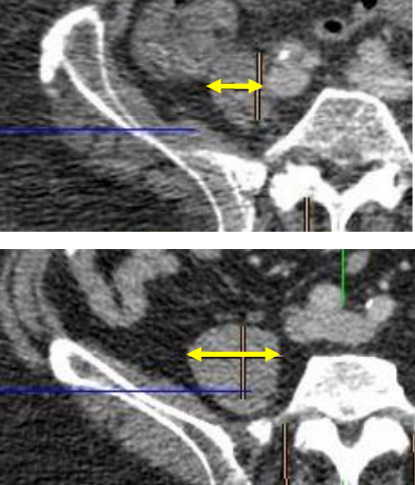
Umbilicus location: in L4 70%, in L5 20% and in L3 10%
Median time between CT scan and TIPS: 542 ±88 days
Assesment was performed by 2 hepatologists trained by an expert radiologist

Slide 7
Statistical analysis
Descriptive statistics for all variables
Non parametric testing was used to compare different groups when suitable
Pared non parametric testing was used to compare data before and after TIPS procedure
ROC analysis with 1 year survival as end point was calculated for the selection of the cuttoff values for TPMT/height
Kaplan-Meier curve with log-rank test was performed for examine impact of muscle indexes on survival and ACLF
Univariate and multivariate analysis was performed with Cox-regression for 1-year mortality, for fatal/non fatal ACLF, occurence of ascites and HE as end points
All values <0.05 from univariare cox regression were used for the multivariate analysis
Bilirubin, Meld, Meld-Na were used separately in multivariate analysis in order to avoid collinearity
Data were analysed using SPSS

Slide 8
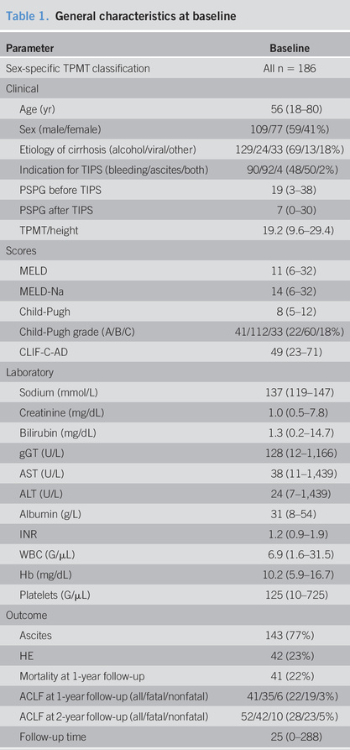
Results
186 pts
59% M
Median age for TIPS 56 yrs
Alcohol most common etiology
52% Refractory ascites, 48% for variceal bleeding
median Meld score 11
median Follow-up was 2.1 yrs

Slide 9
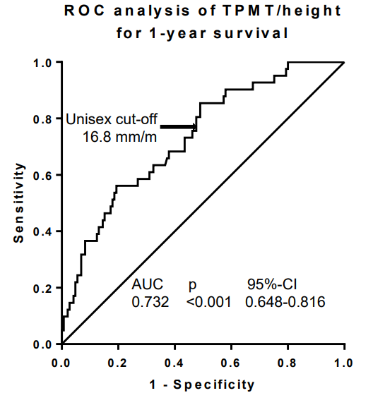
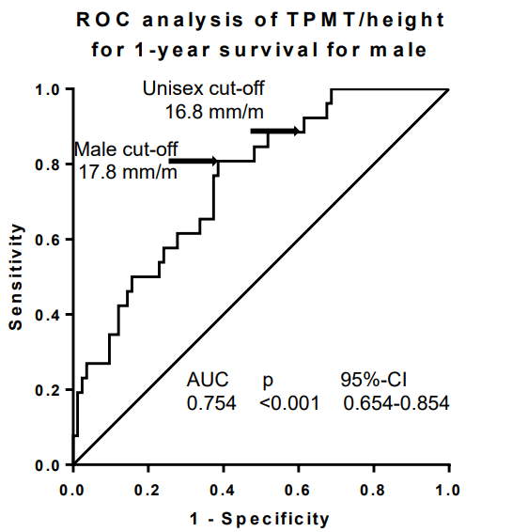
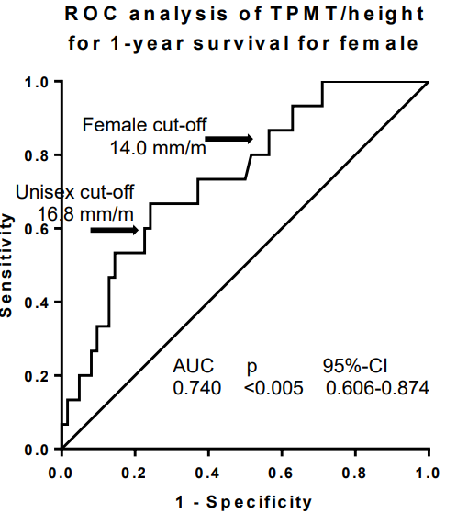
Results
Sarcopenia definition and classification

Slide 10
Results
Sarcopenia and survival
↑ Mortality in sarcopenic patients
Sex specific classifications provides superior discrimination

Slide 11
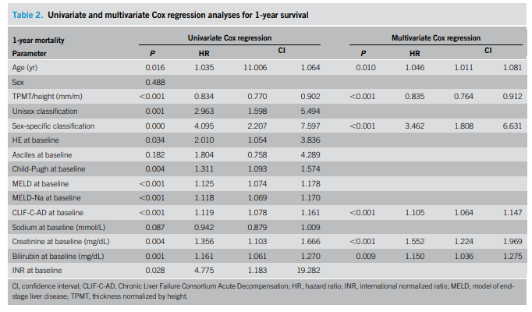
Results
CP score, MELD, MELD-Na, CLIF-C AD, creat, bil, INR, age, TPMT/height, unisex/sex specific sarcopenia classification were dependent risk factors
Sex specific sarcopenia classification, CLIF-C AD, age, creat, bilirubin were indipendent predictors of mortality

Slide 12
Results
Sarcopenia and ACLF

Slide 13
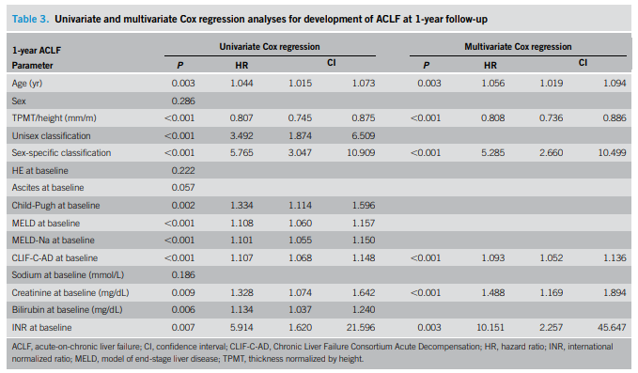
Results
Sarcopenia and ACLF
CP score, MELD, MELD-Na, CLIF-C AD, creat, bil, INR, age, TPMT/height, unisex/sex specific sarcopenia classification were dependent risk factors
Sex specific sarcopenia classification, CLIF-C AD, age, creat, INR were indipendent predictors of 1-yrs ACLF

Slide 14
Sarcopenia and AD

Slide 15
Sarcopenia and systemic inflammation
Sarcopenic group refractory ascites + alcoholic cirrhosis
Before TIPS MELD, MELD-Na, CP score, CLIF-C AD were higher in sarcopenic group vs non sarcopenic
CLIF-C AD decreased in non sarcopenic and increase in sarcopenic
During follow-up all scores improved in the nonsarcopenia group and in the contrary worsened in the sarcopenia group

Slide 16
Sarcopenia and systemic inflammation

Slide 17
Discussion and conclusions
Novel finding of the study: Sarcopenia is associated with development of ACLF
Sarcopenia defined by sex specific TPMT/height identifies patients at risk of development of ACLF and death
Important to notice that 40% of sarcopenic pts developed fatal ACLF but only 10% of non sarcopenic patients developed ACLF
TPMT/height defined sarcopenia is associated with higher rates of overt HE
Sarcopenia is clinical expression of an underlying chronic systemic inflammation
Sarcopenia ↔chronic systemic inflammation and ACLF (?)
TPMT/height measurment is simply, fast and reproducible

Slide 18
Limitations of the study
Selection bias cannot be excluded (retrospective study)
Lack of events of clinical decompensation registered
Technique of estimation of psoas muscle (asymmetrical shape of the psoas muscle)
Umbilicus as anatomical landmark of the psoas
Variable time between the CT scan and TIPS
Bleeders were included, low Meld score at inclusion (?)

Slide 19
Open questions
Is this the time to start using nutritional status assessment as a key requirement in the selection process for TIPS candidates ?
Which one ?

Slide 20
THANK YOU FOR YOUR ATTENTION

