Slide 1
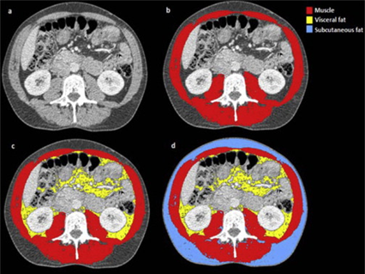
The impact of body mass composition features on the outcome of HCC patients
BACKGROUND
Trends in hepatocellular carcinoma (HCC) have increased over recent decades in most countries(1).
All existing prognostic models for HCC patients have limitations including the subjective nature of assessing functional status (2)
In recent studies the analysis of body composition by imaging techniques proved to be superior to BMI in predicting survival of patients with HCC.
The link between fat/muscle quality and HCC is the vascular endothelial growth factor ( VEGF).
AIMS
to find whether there is a difference in fat (visceral adipose fat and subcutaneous fat) or muscle quality between HCC patients with a good and poor outcome.
to develop and validate a prognostic model for HCC patients using analytic morphomics and pre-treatment clinical/tumor data.
Principal investigator: Prof. Dr. med. Jean-François Dufour
Co-investigators: Dr. Med. Iuliana Pompilia Radu, Clinical Research Associate
Galle P et al. J Hepatol 2016
Kelly CM et al J Oncol. 2016.

