Slide 1
Portal Hypertension Sessions
Tuesday, May 21 2019 – 4.30 pm, MEM
Presenter: Dr Melisa Dirchwolf
Statins for Chronic Liver Disease
Pleiotropic effects of statins
Endothelial function
Liver fibrosis
Portal hypertension
Liver preservation
Prevention of ischemia/reperfusion injury
Prevention of infection related liver failure (ACLF)
Progression of liver disease

Slide 2
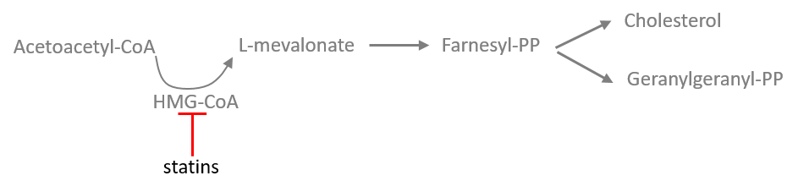
Statins: main function
Statins compete effectively to inhibit HMG CoA reductase and mevalonate production, the rate-limiting step in cholesterol synthesis.
Main Function
Accepted Indications
Cholesterol lowering drugs
Dyslipidemia
Primary and secondary prevention of CV events
Image adapted from Bosch, Gracia, Abraldes. Gut 2019 (submitted)
Notes:
Inhibition of HMG CoA reductase: Lovastatin, simvastatin, pravastatin,
Atorvastatin, fluvastatin, pitavastatin and rosuvastatin are analogs of HydroxiMethilGlutaryl , the precursor of cholesterol. Lovastatin
and simvastatin are lactones that are hydrolyzed to the active
drug. Pravastatin and fluvastatin are active as such. Because of
their strong affinity for the enzyme, all compete effectively to
inhibit HMG CoA reductase, the rate-limiting step in cholesterol
synthesis. By inhibiting de novo cholesterol synthesis, they
deplete the intracellular supply of cholesterol (Figure 21.5).
Pitavastatin, rosuvastatin and atorvastatin are the most potent
LDL cholesterol–lowering statin drugs, followed by simvastatin,
pravastatin, and then lovastatin and fluvastatin.
Increase in LDL receptors: Depletion of intracellular cholesterol
causes the cell to increase the number of specific cell-surface LDL
receptors that can bind and internalize circulating LDLs. Thus, the
end result is a reduction in plasma cholesterol, both by lowered
cholesterol synthesis and by increased catabolism of LDL. [Note:
Because these agents undergo a marked first-pass extraction by
the liver, their dominant effect is on that organ.] The HMG CoA
reductase inhibitors, like the bile acid sequestrant cholestyramine,
can increase plasma HDL levels in some patients, resulting in an
additional lowering of risk for CHD. Decreases in triglyceride also
occur.
Hydrophilic statins, such as pravastatin and rosuvastatin, have less tissue absorption, except for the liver, and fewer side effects due to lower dependence on the cytochrome p450 enzyme. The hepatoselectivity of the statins is related to their lipophilicity. The more lipophilic statins tend to achieve higher levels of exposure in non-hepatic tissues, while the hydrophilic statins tend to be more hepatoselective. The difference in selectivity is because lipophilic statins passively and non-selectively diffuse into both hepatocytic and non-heptatocytic tissue. The hydrophilic statins, such as rosuvastatin and pravastatin, rely largely on active transport (using the organic anion transporting polypeptide, OATP) into hepatocytic tissue to exert their effects. High hepatoselectivity is thought to reduce the risk of adverse side effects, such as myositis and myopathy, with the potential for rhabdomyolysis (the pathological breakdown of skeletal muscle) leading to acute renal failure.
Clinicians differentiate between fat soluble or hydrophobic (atorvastatin, simvastatin, fluvastatin, lovastatin, cerivastatin) and water soluble or hydrophilic statin (rosuvastatin, pravastatin) when prescribing statins depending on potential side effects from treating high cholesterol levels [10]. Lipophilic statins undergo hepatic and enteric metabolism via cytochrome P450 (CYP450 family of enzymes) whereas the water soluble statins are excreted largely unchanged. Pravastatin and rosuvastatin have therefore been not shown to participate in any clinically relevant drug-drug interactions with CYP450 agents. Lipophilic statins may have adverse metabolic consequences that include impaired insulin secretion and promotion of insulin resistance, whereas water soluble statins are better tolerated. For muscle related side effects water soluble statins (pravastatin, rosuvastatin) or modified release fluvastatin are preferred, but not for rhabdomyolysis where further statin treatment is contraindicated

Slide 3
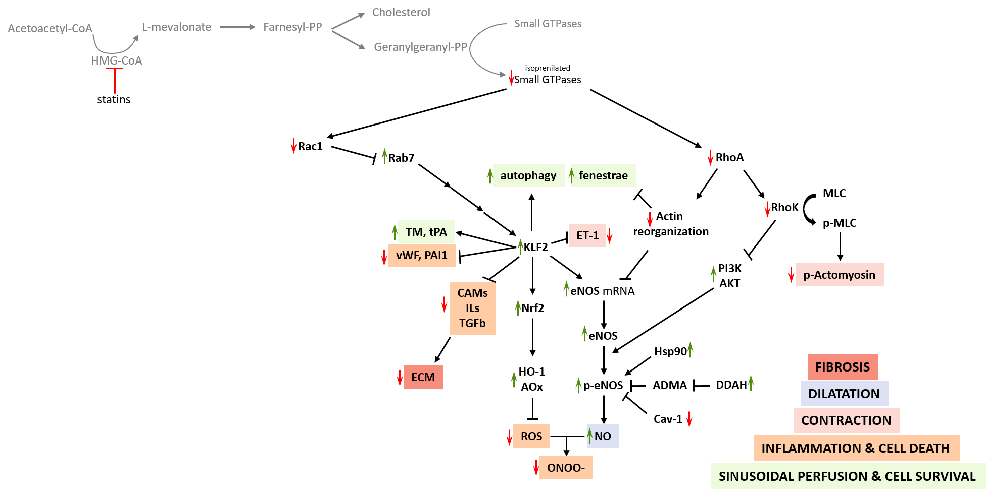
Statins pleiotropism: cholesterol independent effects
All pleiotropic effects: also mediated by inhibition of mevalonate synthesis in the vascular wall.
Inhibition of isoprenoid intermediates farnesyl-pyrophosphate and geranylgeranyl-pyrophosphate that are necessary for membrane translocation and activation of GTPases RhoA and Rac1
These GTPases are critical signaling molecules for cellular functions
Image from Bosch, Gracia, Abraldes. Gut 2019 (submitted)

Slide 4
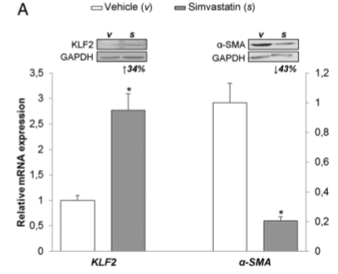
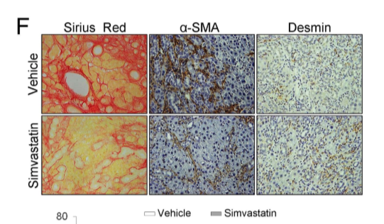

STATINS – Pre-clinical studies: Rac1/KLF2 pathway
KLF2 exerts antiﬁbrotic and vasoprotective effects in cirrhotic rat livers: behind the molecular mechanisms of statins. G Marrone, R Maeso-Díaz, G García-Cardena, JG Abraldes, JC García-Pagán, J Bosch, J Gracia-Sancho. Gut 2015
TF Kruppel-like ft2: induced early in cirrhosis progression to lessen vascular dysfunction
Activation phenotype of KLF2 in human and rat cirrhotic hepatic stellate cells (HSC) with SMV, adenovirus codifying for KLF2 or vehicle
SMV up-regulated KLF2 and thus decreased HSC activation markers α-smooth muscle actin (α-SMA) and procollagen I
SMV ameliorated HSC phenotype
Cirrhotic rats treated during 3 days with SMV exhibited upregulation in KLF2 expression, HSC deactivation and diminution in PP and liver fibrosis
Notes:
Objective In the liver, the transcription factor, Kruppellike factor 2 (KLF2), is induced early during progression of cirrhosis to lessen the development of vascular dysfunction; nevertheless, its endogenous expression results insufﬁcient to attenuate establishment of portal hypertension and aggravation of cirrhosis. Herein, we aimed to explore the effects and the underlying mechanisms of hepatic KLF2 overexpression in in vitro and in vivo models of liver cirrhosis. Design Activation phenotype was evaluated in human and rat cirrhotic hepatic stellate cells (HSC) treated with the pharmacological inductor of KLF2 simvastatin, with adenovirus codifying for this transcription factor (Ad-KLF2), or vehicle, in presence/absence of inhibitors of KLF2. Possible paracrine interactions between parenchymal and non-parenchymal cells overexpressing KLF2 were studied. Effects of in vivo hepatic KLF2 overexpression on liver ﬁbrosis and systemic and hepatic haemodynamics were assessed in cirrhotic rats. Results KLF2 upregulation profoundly ameliorated HSC phenotype (reduced α-smooth muscle actin, procollagen I and oxidative stress) partly via the activation of the nuclear factor (NF)-E2-related factor 2 (Nrf2). Coculture experiments showed that improvement in HSC phenotype paracrinally ameliorated liver sinusoidal endothelial cells probably through a vascular endothelial growth factormediated mechanism. No paracrine interactions between hepatocytes and HSC were observed. Cirrhotic rats treated with simvastatin or Ad-KLF2 showed hepatic upregulation in the KLF2-Nrf2 pathway, deactivation of HSC and prominent reduction in liver ﬁbrosis. Hepatic KLF2 overexpression was associated with lower portal pressure (–15%) due to both attenuations in the increased portal blood ﬂow and hepatic vascular resistance, together with a signiﬁcant improvement in hepatic endothelial dysfunction. Conclusions Exogenous hepatic KLF2 upregulation improves liver ﬁbrosis, endothelial dysfunction and portal hypertension in cirrhosis.
Among the non-parenchymal cell alterations, liver sinusoidal endothelial cells (LSEC) become dysfunctional and lose their unique characteristics to acquire a vasoconstrictor, prothrombotic and proinﬂammatory phenotypes,2 while hepatic stellate cells (HSC), which modulate liver contractility and extracellular matrix deposition, transdifferentiate and proliferate, becoming activated and phenotypically different from the normal quiescent HSC.34Therefore, an efﬁcient modulation of the injured hepatic microvascular phenotype, especially the activated HSC and the dysfunctional LSEC, may lead to a signiﬁcant amelioration of liver cirrhosis. In fact, most of the reported antiﬁbrotic treatments were aimed at inhibiting HSC transdifferentiation and proliferation, or at regulating HSC apoptosis
Signiﬁcance of this study
What is already known on this subject? ▸ The transcription factor Kruppel-like factor 2 (KLF2) confers protection to endothelial cells through the induction of vasoprotective genes. ▸ In cirrhosis, KLF2 is overexpressed early during the progression of the disease; nevertheless, it is not enough to slow down the development of vascular dysfunction. What are the new ﬁndings? ▸ Pharmacological or adenoviral upregulation of hepatic KLF2 expression induces a profound amelioration in portal hypertension and cirrhosis. ▸ KLF2 beneﬁcial effects are mainly due to hepatic stellate cells inactivation and apoptosis, together with reduction in hepatic oxidative stress and improvement in endothelial function. How might it impact on clinical practice in the foreseeable future? ▸ Speciﬁc induction of hepatic KLF2 within the liver represents an easy and highly effective strategy to promote regression of liver cirrhosis and amelioration of portal hypertension.

Slide 5
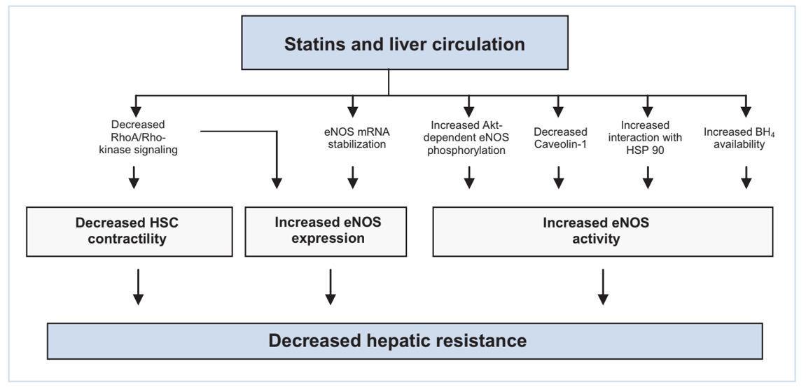
Statins pleiotropic effects: endothelial dysfunction and PH
Bosch et al, J Hepatol 2010
Notes:
Hepatic endothelial dysfunction and abnormal angiogenesis:
New targets in the treatment of portal hypertension
Jaume Bosch*, Juan G. Abraldes, Mercedes Fernández, Juan Carlos García-Pagán
Fig. 2. Mechanisms mediating the decrease in hepatic resistance by statins. Statins increase eNOS expression and activity. The most immediate effect of statins on
endothelial NO production is an increase in eNOS phosphorylation at Ser 1177/1179, with subsequent increased activity [43]. This is mediated by the activation of the
phosphatidyl inositol 3-kinase (PI3K)/Akt pathway [43] that leads to an increase in Akt phosphorylation at Ser473 with ensuing eNOS phosphorylation [47]. Statins reduce
the expression of the eNOS inhibitory protein caveolin-1 [86] and increase the interaction of eNOS with its stimulatory protein Hsp90 [86]. These effects occur slower than
the PI3K/Akt pathway activation. Statins also increase the expression of GTP cyclohydrolase I (GTPCH) [87], the rate-limiting enzyme for de novo synthesis of
tetrahydrobiopterin (BH4), a cofactor that increases eNOS activity by preventing eNOS uncoupling and, thus, superoxide generation. Statins also upregulate eNOS expression
by increasing eNOS mRNA stability [48]. Lastly, statins inhibit hepatic RhoA/Rho kinase signalling, which increases eNOS expression and decreases hepatic stellate cell
(HSC) contractility [49].

Slide 6
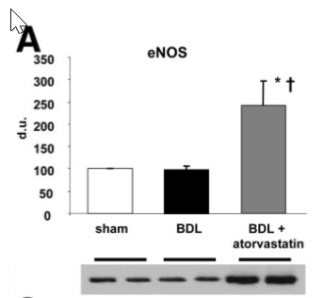
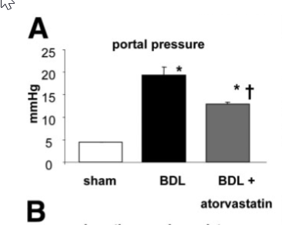
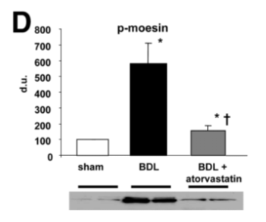
STATINS – Pre-clinical studies: RhoA/Rho kinase pathway
Atorvastatin Lowers Portal Pressure in Cirrhotic Rats by Inhibition of RhoA/Rho-kinase and Activation of Endothelial Nitric Oxide Synthase J Trebicka, M Hennenberg, W Laleman, N Shelest, E Biecker, M Schepke, F Nevens, T Sauerbruch and J Heller. Hepatology 2007
CBDL mice and HSC ± ATV 1 week
Decreased IH P-moesin: inhibition Rho-kinase
Increased eNOS liver content
Decrease in portal pressure
In cirrhotic rats, atorvastatin inhibits hepatic RhoA/Rho-kinase signaling and activates the NO/PK G-pathway. This lowers intrahepatic resistance, resulting in decreased portal pressure.
Notes:
In cirrhosis, increased RhoA/Rho-kinase signaling and decreased nitric oxide (NO) availability contribute to increased intrahepatic resistance and portal hypertension. Hepatic stellate cells(HSCs) regulate intrahepatic resistance. 3-Hydroxy-3-methylglutaryl coenzyme A reductase in-hibitors (statins) inhibit synthesis of isoprenoids, which are necessary for membrane transloca-tion and activation of small GTPases like RhoA and Ras. Activated RhoA leads to Rho-kinaseactivation and NO synthase inhibition. We therefore investigated the effects of atorvastatin incirrhotic rats and isolated HSCs. Rats with secondary biliary cirrhosis (bile duct ligation, BDL)were treated with atorvastatin (15 mg/kg per day for 7 days) or remained untreated. Hemody-namic parameters were determined in vivo (colored microspheres). Intrahepatic resistance wasinvestigated in in situ perfused livers. Expression and phosphorylation of proteins were analyzedby RT-PCR and immunoblots. Three-dimensional stress-relaxed collagen lattice contractions ofHSCs were performed after incubation with atorvastatin. Atorvastatin reduced portal pressurewithout affecting mean arterial pressure in vivo. This was associated with a reduction in intra-hepatic resistance and reduced responsiveness of in situ–perfused cirrhotic livers to methox-amine. Furthermore, atorvastatin reduced the contraction of activated HSCs in a 3-dimensionalstress-relaxed collagen lattice. In cirrhotic livers, atorvastatin signiﬁcantly decreased Rho-kinaseactivity (moesin phosphorylation) without affecting expression of RhoA, Rho-kinase and Ras. Inactivated HSCs, atorvastatin inhibited the membrane association of RhoA and Ras. Furthermore,in BDL rats, atorvastatin signiﬁcantly increased hepatic endothelial nitric oxide synthase (eNOS)mRNA and protein levels, phospho-eNOS, nitrite/nitrate, and the activity of the NO effector protein kinase G (PKG). Conclusion: In cirrhotic rats, atorvastatin inhibits hepatic RhoA/Rho-kinase signaling and activates the NO/PKG-pathway. This lowers intrahepatic resistance, result-ing in decreased portal pressure. Statins might represent a therapeutic option for portalhypertension in cirrhosis.

Slide 7

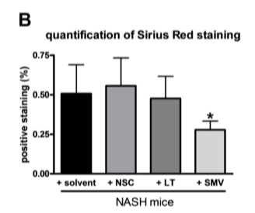
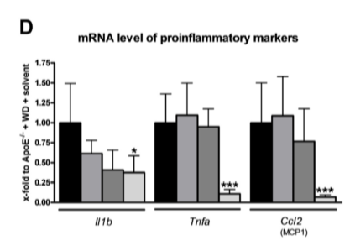
STATINS – Pre-clinical studies: RhoA/Rho kinase pathway
Statins improve NASH via inhibition of RhoA and Ras. R Schierwagen, L Maybüchen, K Hittatiya, S Klein, FE. Uschner, TT. Braga, BS. Franklin, G Nickenig, CP. Strassburg, J Plat, T Sauerbruch, E Latz, D Lütjohann, S Zimmer, and J Trebicka. Gut 2016
Inhibition of small GTPases by drugs by minipumps 6 wks in a NASH mice model
SMV signiﬁcantly decreased hepatic inﬂammation and ﬁbrosis
No signiﬁcant effect on steatosis
SMV blunted ﬁbrosis due to inhibition of RhoA/Rho kinase and Ras/ERK pathways
SMV (Rac1/Ras/RhoA inhibitor) decreased hepatic inflammation and fibrosis
Fibrosis
Inflammation
Notes:
Nonalcoholic steatohepatitis (NASH), especially as part of the metabolic syndrome (MS), is an increasing burden in Western countries. Statins are already used in MS and seem to be beneﬁcial in liver diseases. The aim of this study was to investigate the molecular mechanisms underlying pleiotropic effects on small GTPases of statins in NASH. NASH within MS was induced in 12-wk-old apoE/ mice after 7 wk of Western diet (NASH mice). Small GTPases were inhibited by activated simvastatin (SMV), NSC23766 (NSC), or Clostridium sordellii lethal toxin (LT) by using subcutaneous osmotic minipumps. Hepatic steatosis, inﬂammation, and ﬁbrosis were assessed by histology, Western blot, and RT-PCR measurements of cholesterol and hydroxyproline content. SMV treatment signiﬁcantly decreased hepatic inﬂammation and ﬁbrosis, but had no signiﬁcant effect on steatosis and hepatic cholesterol content in NASH. SMV blunted ﬁbrosis due to inhibition of both RhoA/Rho kinase and Ras/ERK pathways. Interestingly, inhibition of RAC1 and Ras (by LT) failed to decrease ﬁbrosis to the same extent. Inhibition of RAC1 (by NSC) showed no signiﬁcant effect at all. Inhibition of RhoA and Ras downstream signaling by statins is responsible for the beneﬁcial hepatic effects in NASH.
HSC activation was investigated by the surrogate marker SMA. After 6 wk of treatment with NSC (RAC1 inhibitor), LT (RAC1/Ras inhibitor), or SMV (RAC1/Ras/RhoA inhibitor), SMA-positive staining was decreased. However, only SMV showed a signiﬁcant decrease in SMA-positive staining compared with the untreated NASH mice (Fig. 5, A and B). Findings on the protein level were conﬁrmed by transcriptional levels of SMA, which showed a signiﬁcant decrease in NASH mice treated with SMV compared with untreated littermates (Fig. 5C). Besides SMA immunohistochemistry and measurements of gene transcription, conﬁrmative Western blot analysis demonstrates a signiﬁcant decrease of SMA in mice treated with SMV, whereas there was only a tendency toward decreased SMA in mice treated with NSC or LT

Slide 8

STATINS – Pleiotropic effects
Effects on liver pathophysiology
Ischemia/reperfusion
Preservation

Slide 9
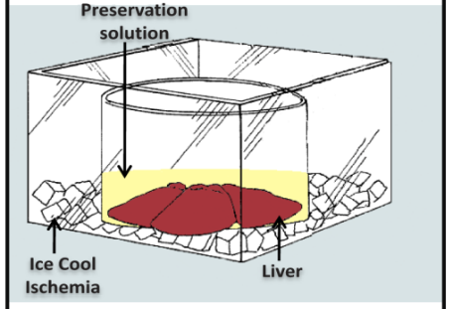
STATINS – Pre-clinical studies: Preservation
Simvastatin maintains function and viability of steatotic rat livers procured for transplantation. Gracia-Sancho J, García-Calderó H, Hide D, Marrone G, Guixé-Muntet S, Peralta C, García-Pagán JC, Abraldes JG, Bosch J. J Hepatol. 2013
SMV ameliorates increase in PPP
SMV improves vasorelaxation due to Ach
SMV mantained eNOS expression
Simvastatin markedly improved liver injury and prevented hepatic endothelial dysfunction
Mice steatotic livers with/without SMV
Grafts with/without cold storage and reperfusion
Plac.
SMV
Notes:
As shown in Fig. 2A, cold-stored and warm-reperfused steatotic
livers exhibited microcirculation deterioration upon reperfusion,
as demonstrated by markedly increased portal perfusion pressure
compared to no-cold-stored livers. Such increments in portal perfusion
pressure were not observed in cold-stored steatotic liver
grafts from rats pretreated with simvastatin.
Additionally, cold-stored steatotic livers exhibited endothelial
dysfunction. Fig. 2B demonstrates that steatotic grafts cold stored
and warm reperfused exhibit only a mild vasorelaxation in
response to acetylcholine (Ach) at 107 and 106 doses, and a
paradoxical vasoconstriction at the 105 dose of Ach. Liver vasorelaxation
was marked and significantly improved when rats
were pretreated with simvastatin (Fig. 2B).

Slide 10
STATINS – Pre-clinical studies: Hemorrhage/Resuscitation
Simvastatin Attenuates Liver Injury in Rodents with Biliary Cirrhosis Submitted to Hemorrhage/Resuscitation. Meireles CZ, Pasarin M, Lozano JJ, García-Calderó H, Gracia-Sancho J, García-Pagán JC, Bosch J, Abraldes JG. Shock 2017
Controls and biliary cirrhotic rodents with/without SMV were exposed to H/R procedure
Assessment of liver sinusoidal endothelial function after H/R or SHAM
SMV prevented H/R-induced liver endothelial dysfunction, and attenuated liver injury and liver inflammatory response
SMV might have potential for protecting the cirrhotic liver during bleeding complications.
Notes:
ABSTRACT—Liver function deterioration is a major cause of death in variceal bleeding. The effects of bleeding on
intrahepatic microvascular dysfunction, which contributes to liver injury in cirrhosis, are largely unknown. The aims of this
study were to evaluate the impact of hemorrhage/resuscitation (H/R) on cirrhotic microcirculation, and whether simvastatin,
a drug that improves liver microcirculation, has hepatoprotective effects. The study was performed in three groups of rats:
controls, rats with biliary cirrhosis (CBDL), and CBDL rats pretreated with three doses (5 mg kg1 day1) of simvastatin.
Rats were submitted to H/R or sham procedure. Subsequently, livers were isolated and perfused for functional assessment
of liver microcirculation. Liver transcriptome was assessed with microarrays. H/R significantly impaired endothelialdependent
vasorelaxation in cirrhotic (P¼0.035) but not control livers. H/R induced a similar increase in ALT in control
and cirrhotic rats, whereas the increase in AST was 10 times higher in cirrhotic than in control rats (P¼0.007). Simvastatin
prevented the impairment in endothelial-dependent vasorelaxation induced by H/R, and reduced by half the increase in ALT
and AST (P<0.05). Transcriptomics showed a marked upregulation of genes related to inflammatory response after H/R in
cirrhotic livers, but not in controls, and this was blunted by simvastatin. In conclusion, H/R aggravates liver microvascular
dysfunction in cirrhosis, and upregulates liver inflammatory pathways. This does not occur in control livers. Simvastatin
prevented H/R-induced liver endothelial dysfunction, and attenuated liver injury and liver inflammatory response, suggesting
that it might have potential for protecting the cirrhotic liver during bleeding complications.

Slide 11
STATINS – Pleiotropic effects
Effects on liver pathophysiology
Ischemia/reperfusion
Preservation
Infection

Slide 12
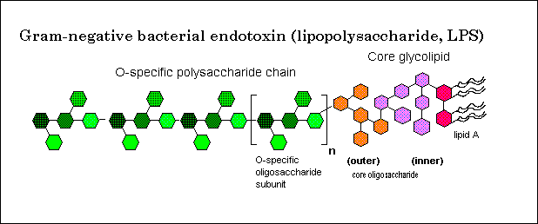


STATINS – Pre-clinical studies: Infection
Effects of Simvastatin Administration on Rodents With Lipopolysaccharide-Induced Liver Microvascular Dysfunction. V La Mura, M Pasarin, CZ Meireles, R Miquel, A Rodriguez-Vilarrupla, D Hide, J Gracia-Sancho, JC Garcia-Pagan, J Bosch and JG Abraldes. Hepatology 2013
LPS
In control mice, LPS induced:
Increase in baseline PPP
Decrease vasodilation to ACH
Reduced eNOS activation
Liver inﬂammation.
In mice with 3 days SMV:
Prevention of the increase in PPP
Normalization of the response to ACH
Reduced liver inﬂammation
Liver protection during endotoxemia
Mice ± SMV 3 days prior or 3-23hrs after exposure
Notes:
Endothelial dysfunction drives vascular derangement and organ failure associated with sepsis. However, the consequences of sepsis on liver sinusoidal endothelial function arelargely unknown. Statins might improve microvascular dysfunction in sepsis. The presentstudy explores liver vascular abnormalities and the effects of statins in a rat model of endo-toxemia. For this purpose, lipopolysaccharide (LPS) or saline was given to: (1) rats treatedwith placebo; (2) rats treated with simvastatin (25 mg/kg, orally), given at 3 and 23 hoursafter LPS/saline challenge; (3) rats treated with simvastatin (25 mg/kg/24 h, orally) from 3days before LPS/saline injection. Livers were isolated and perfused and sinusoidal endo-thelial function was explored by testing the vasodilation of the liver circulation to increas-ing concentrations of acetylcholine. The phosphorylated endothelial nitric oxide synthase(PeNOS) / endothelial nitric oxide synthase (eNOS) ratio was measured as a marker ofeNOS activation. LPS administration induced an increase in baseline portal perfusionpressure and a decrease in vasodilation to acetylcholine (sinusoidal endothelial dysfunc-tion). This was associated with reduced eNOS phosphorylation and liver inﬂammation.Simvastatin after LPS challenge did not prevent the increase in baseline portal perfusionpressure, but attenuated the development of sinusoidal endothelial dysfunction. Treatmentwith simvastatin from 3 days before LPS prevented the increase in baseline perfusion pres-sure and totally normalized the vasodilating response of the liver vasculature to acetylcho-line and reduced liver inﬂammation. Both protocols of treatment restored a physiologicPeNOS/eNOS ratio. Conclusion: LPS administration induces intrahepatic endothelial dys-function that might be prevented by simvastatin, suggesting that statins might have poten-tial for liver protection during endotoxemia.

Slide 13
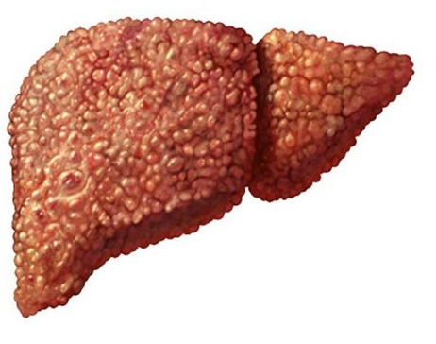
STATINS – Pleiotropic effects
Effects on liver pathophysiology
Cirrhosis
Portal hypertension
Ischemia/reperfusion
Preservation
Infection

Slide 14
STATINS – Pre-clinical studies: Endothelial dysfunction and Portal hypertension
Simvastatin treatment improves liver sinusoidal endothelial dysfunction in CCl4 cirrhotic rats. Abraldes JG, Rodríguez-Vilarrupla A, Graupera M, Zafra C, García-Calderó H, García-Pagán JC, Bosch J. J Hepatol 2007
Cirrhotic rats were treated with SMV or placebo (3d)
SMV did not changed systemic hemod.
SMV attenuated PP increase after volumen expantion
SMV increased eNOS expression and Akt-mediated eNOS phosphorylation
SMV: selectively increase NO availability in the cirrhotic liver circulation
Haemod. measured at baseline and after volumen expansion
Notes:
Simvastatin treatment improves liver sinusoidal endothelial dysfunction in CCl4 cirrhotic rats.
Abraldes JG¹, Rodríguez-Vilarrupla A, Graupera M, Zafra C, García-Calderó H, García-Pagán JC, Bosch J.
Author information
Abstract
BACKGROUND/AIMS:
Sinusoidal endothelial dysfunction with decreased nitric oxide (NO) production contributes to increased hepatic resistance in cirrhosis. Statins improve endothelial dysfunction in peripheral vasculature. This study was designed to characterize the hemodynamic and molecular effects of statins in cirrhotic rats.
METHODS:
Systemic and splanchnic hemodynamics were evaluated in CCl(4) ascitic cirrhotic rats treated with placebo or simvastatin (25 mg/kg/day, for 3 days), at baseline and after volume expansion. Vascular responses of liver vasculature were evaluated after isolation and perfusion of the liver.
RESULTS:
There were no differences in baseline hemodynamics in rats treated with simvastatin or placebo. However, in rats treated with simvastatin the increase in portal pressure induced by volume expansion was significantly attenuated. In isolated and perfused cirrhotic livers simvastatin pre-treatment significantly attenuated the pressure response to methoxamine, and significantly improved paradoxical vasoconstriction induced by acetylcholine. These effects were not observed in the presence of a nitric oxide synthase inhibitor. Simvastatin increased eNOS expression, Akt-dependent eNOS phosphorylation and cGMP liver content.
CONCLUSIONS:
The administration of simvastatin might constitute a new way to selectively increase NO availability in the cirrhotic liver circulation and, therefore improve the vascular disturbances that contribute to portal hypertension.
PMID: 17335931 DOI: 10.1016/j.jhep.2007.01.020

Slide 15
STATINS – Pleiotropic effects
Effects on liver pathophysiology
Acute-on-chonic liver failure
Ischemia/reperfusion
Preservation
Infection
Cirrhosis
Portal hypertension

Slide 16
STATINS – pre-clinical studies: ACLF
Simvastatin Prevents Progression of Acute on Chronic Liver Failure in Rats With Cirrhosis and Portal Hypertension. Tripathi DM, Vilaseca M, Lafoz E, Garcia-Calderó H, Viegas Haute G, Fernández-Iglesias A, Rodrigues de Oliveira J, García-Pagán JC, Bosch J, Gracia-Sancho J. Gastroenterology 2018
Simvastatin reduced LPS-induced inflammation and liver damage in rats with ACLF
Simvastatin prevented most of ACLF-derived complications and increased survival
Notes:
BACKGROUND & AIMS: Cirrhosis and its clinical consequences
can be aggravated by bacterial infections, ultimately leading to
the development of acute on chronic liver failure (ACLF),
characterized by acute decompensation, organ failure, and high
mortality within 28 days. Little is known about cellular and
molecular mechanisms of ACLF in patients with cirrhosis, so no
therapeutic options are available. We developed a sepsisassociated
preclinical model of ACLF to facilitate studies of
pathogenesis and evaluate the protective effects of simvastatin.
METHODS: Male Wistar rats inhaled CCl4 until they developed
cirrhosis (at 10 weeks) or cirrhosis with ascites (at 15–16
weeks). Male Sprague-Dawley rats received bile-duct ligation
for 28 days or intraperitoneal thioacetamide for 10 weeks to
induce cirrhosis. After induction of cirrhosis, some rats received
a single injection of lipopolysaccharide (LPS) to induce ACLF;
some were given simvastatin or vehicle (control) 4 hours or 24
hours before induction of ACLF. We collected data on changes
in hepatic and systemic hemodynamics, hepatic microvascular
phenotype and function, and survival times. Liver tissues and
plasma were collected and analyzed by immunoblots, quantitative
polymerase chain reaction, immuno(fluoro)histochemistry
and immunoassays. RESULTS: Administration of LPS
aggravated portal hypertension in rats with cirrhosis by
increasing the severity of intrahepatic microvascular dysfunction,
exacerbating hepatic inflammation, increasing oxidative
stress, and recruiting hepatic stellate cells and neutrophils. Rats
with cirrhosis given LPS had significantly shorter survival times
than rats with cirrhosis given the control. Simvastatin prevented
most of ACLF-derived complications and increased
survival times. Simvastatin appeared to increase hepatic sinusoidal
function and reduce portal hypertension and markers of
inflammation and oxidation. The drug significantly reduced
levels of transaminases, total bilirubin, and ammonia, as well as
LPS-mediated activation of hepatic stellate cells in liver tissues
of rats with cirrhosis. CONCLUSIONS: In studies of rats with
cirrhosis, we found administration of LPS to promote development
of ACLF, aggravating the complications of chronic liver
disease and decreasing survival times. Simvastatin reduced
LPS-induced inflammation and liver damage in rats with ACLF,
supporting its use in treatment of patients with advanced
chronic liver disease.

Slide 17
STATINS – Pleiotropic effects
Clinical research
Randomized controlled trials:
Portal Hypertension
Decompensation (rebleeding)
Survival

Slide 18
STATINS – Clinical studies: Endothelial dysfunction and Portal hypertension
Simvastatin Enhances Hepatic Nitric Oxide Production and Decreases the Hepatic Vascular Tone in Patients With Cirrhosis. C. ZAFRA, JG. ABRALDES, J. TURNES, A. BERZIGOTTI, M. FERNANDEZ, JC. GARCIA-PAGAN, J. RODES, and J. BOSCH. Gastroenterology 2004
Measurement of acute response to SMV in 13 pts: HVPG, hepatic blood flow, CO, NO
Acute: HBF and HSR
After meal: SMV attenuated HVPG increase
hepatic sinusoidal resistance
NO in hepatic venous blood
Study with 2 protocols
Repetead measurements of hepatic hemod. after meal in 17 pts with SMV or placebo
SMV
Placeb
Placeb
SMV
POSTPRANDIAL
Notes:
Background & Aims: In cirrhosis, an insufficient release
of nitric oxide contributes to increased hepatic resistance
and portal pressure and enhances the postprandial
increase in portal pressure. We hypothesized that
simvastatin, which enhances Akt-dependent endothelial
nitric oxide synthase phosphorylation, may increase hepatic
nitric oxide release and decrease hepatic resistance
in patients with cirrhosis and portal hypertension.
Methods: In protocol 1, 13 patients had measurements
of the hepatic venous pressure gradient, hepatic blood
flow, mean arterial pressure, cardiac output, and nitric
oxide products before and 30 and 60 minutes after 40
mg of simvastatin. In protocol 2, 17 patients were randomized
to receive placebo or simvastatin (40 mg) 12
hours and 1 hour before the study. After baseline measurements
of the hepatic venous pressure gradient, hepatic
blood flow, and nitric oxide products, a standard
liquid meal was given, and measurements were repeated
at 15, 30, and 45 minutes. Results: In protocol 1,
acute simvastatin did not modify the hepatic venous
pressure gradient but increased the hepatic blood flow
(21% 13% at 30 minutes; P 0.01) and decreased
hepatic sinusoidal resistance by 14% 11% (P 0.04).
Nitric oxide product levels significantly increased in hepatic
venous blood (from 31.4 12.3 nmol mL1 to
35.8 10.7 nmol mL1; P 0.04), but not in peripheral
blood. Systemic hemodynamics were not modified.
In protocol 2, simvastatin pretreatment significantly attenuated
the postprandial increase in hepatic venous
pressure gradient (mean peak increase, 10% 9% vs.
21% 6% in placebo; P 0.01). Hepatic blood flow
increased similarly in the 2 groups. Hepatic nitric oxide
products increased in the simvastatin group but not in
the placebo group. Conclusions: Simvastatin administration
increases the hepatosplanchnic output of nitric oxide
products and decreases hepatic resistance in patients
with cirrhosis.

Slide 19
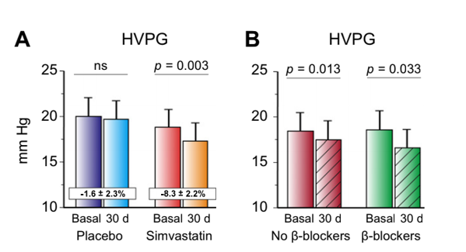
STATINS – Clinical studies: Endothelial dysfunction and Portal hypertension
Simvastatin lowers portal pressure in patients with cirrhosis and portal hypertension: a randomized controlled trial. J. ABRALDES, A. ALBILLOS, R.BAÑARES, J. TURNES, R. GONZÁLEZ, JC. GARCÍA–PAGÁN, and J. BOSCH. Gastroenterology 2009
Randomization of 59 pts with CSPH (HVPG >12 mm Hg) to simvastatin 20/40mg or placebo for 1 month
SMV significantly decreased HVPG vs placebo in severe PH
Mantained effects in NSBB group and decompensated cirrosis
Simvastatin improved clearance of indocyanine green, showing an improvement in effective liver perfusion and function
Bosch et al, J Hepatol 2010
Notes:
Background & Aims: Simvastatin improves liver gen-Effects of simvastatin (shaded bars) and placebo (white bars) on HVPG in the (A) overall series (P .041) and stratified by (B) previous -blocker treatment (adjusted P value .033) and (C) previous decompensation (adjusted P value .038). eration of nitric oxide and hepatic endothelial dys-
function in patients with cirrhosis, so it could be an
effective therapy for portal hypertension. This ran-
domized controlled trial evaluated the effects of con-
tinuous simvastatin administration on the hepatic
venous pressure gradient (HVPG) and its safety in
patients with cirrhosis and portal hypertension.
Methods: Fifty-nine patients with cirrhosis and por-
tal hypertension (HVPG >12 mm Hg) were random-
ized to groups that were given simvastatin 20 mg/day
for 1 month (increased to 40 mg/day at day 15) or
placebo in a double-blind clinical trial. Randomiza-
tion was stratified according to whether the patient
was being treated with -adrenergic blockers. We
studied splanchnic and systemic hemodynamics and
variables of liver function and safety before and after
1 month of treatment. Results: Simvastatin signifi-
cantly decreased HVPG (8.3%) without deleterious
effects in systemic hemodynamics. HVPG decreases
were observed in patients who were receiving -ad-
renergic blockers (11.0%; P .033) and in those
who were not (5.9%; P .013). Simvastatin im-
proved hepatic, fractional, and intrinsic clearance of
indocyanine green, showing an improvement in effec-
tive liver perfusion and function. No significant
changes in HVPG and liver function were observed in
patients receiving placebo. The number of patients
with adverse events did not differ significantly be-
tween groups. No patient was withdrawn from the
study based on adverse events. Conclusions: Simva-
statin decreased HVPG and improved liver perfusion
in patients with cirrhosis. These effects were additive
with those of -adrenergic blockers. The beneficial
effects of simvastatin should be confirmed in long-
term clinical trials for portal hypertension.

Slide 20
STATINS – Clinical trial: Decompensation and death
Addition of Simvastatin to Standard Therapy for the Prevention of Variceal Rebleeding Does Not Reduce Rebleeding but Increases Survival in Patients With Cirrhosis. Abraldes JG, Villanueva C, Aracil C, Turnes J, Hernandez-Guerra M, Genesca J, Rodriguez M, Castellote J, García-Pagán JC, Torres F, Calleja JL, Albillos A, Bosch J; BLEPS Study Group. Gastroenterology 2016
Multicenter, double-blind, parallel trial of 158 patients with cirrhosis receiving standard 2nd prophylaxis with/without SMV – FU 24 months
Addition of SMV to standard therapy did not reduce rebleeding, but was associated with a survival benefit for patients with Child-Pugh class A or B cirrhosis.
The incidence of rhabdomyolysis in patients receiving 40 mg/d SMV was higher than expected
Notes:
BACKGROUND & AIMS: The combination of b-blockers and
band ligation is the standard approach to prevent variceal
rebleeding, but bleeding recurs and mortality is high. The lipidlowering
drug simvastatin decreases portal pressure, improves
hepatocellular function, and might reduce liver fibrosis. We
assessed whether adding simvastatin to standard therapy could
reduce rebleeding and death after variceal bleeding in patients
with cirrhosis. METHODS: We performed a multicenter,
double-blind, parallel trial of 158 patients with cirrhosis
receiving standard prophylaxis to prevent rebleeding (a
b-blocker and band ligation) in Spain from October 2010
through October 2013. Within 10 days of bleeding, subjects
were randomly assigned, but stratified by Child-Pugh class of A
or B vs C, to groups given simvastatin (20 mg/d the first 15
days, 40 mg/d thereafter; n ¼ 69) or placebo (n ¼ 78). Patients
were followed for as long as 24 months. The primary end point
was a composite of rebleeding and death, and main secondary
end points were the individual components of the composite
(death and rebleeding). RESULTS: The primary end point was
met by 30 of 78 patients in the placebo group and 22 of 69 in
the simvastatin group (P ¼ .423). Seventeen patients in the
placebo group died (22%) vs 6 patients in the simvastatin
group (9%) (hazard ratio for adding simvastatin to therapy ¼
0.39; 95% confidence interval: 0.15–0.99; P ¼ .030). Simvastatin
did not increase survival of patients with Child-Pugh
class C cirrhosis. Rebleeding occurred in 28% of patients in
the placebo group and 25% in the simvastatin group (P ¼ .583).
Serious adverse events occurred in 53% of patients in the
placebo group and 49% in the simvastatin group (P ¼ .752);
the percentages of serious adverse events related to therapy
were 11% in the placebo group vs 8% in the in the simvastatin
group (P ¼ .599). Two patients in the simvastatin group, each
with advanced liver disease, developed rhabdomyolysis.
CONCLUSIONS: In a randomized controlled trial, addition of
simvastatin to standard therapy did not reduce rebleeding, but
was associated with a survival benefit for patients with Child-
Pugh class A or B cirrhosis. Survival was not the primary end
point of the study, so these results require validation. The
incidence of rhabdomyolysis in patients receiving 40 mg/
d simvastatin was higher than expected. European Clinical Trial
Database ID: EUDRACT 2009-016500-24; ClinicalTrials.gov ID:
NCT01095185.

Slide 21
STATINS – Pleiotropic effects
Clinical research
Randomized controlled trials:
Portal Hypertension
Decompensation (rebleeding)
Survival
Observational Studies
Fibrosis progression
Cirrhosis decompensation
Infection
NAFLD/NASH

Slide 22
STATINS – Clinical studies: Liver fibrosis
Statin use and the risk of cirrhosis development in patients with hepatitis C virus infection. Yao-Hsu Yang, Wen-Cheng Chen, Yu-Tse Tsan, Mei-Jyh Chen, Wei-Tai Shih, Ying-Huang Tsai, Pau-Chung Chen. J Hepatol 2015
Population-based cohort study Taiwan Health Insurance Database
Each patient was followed from 1997 to 2010 to identify incident cases of cirrhosis
Risk cirrhosis development
Incidence Cirrhosis
No statins
34,273 cases of cirrhosis identified in the HCV-cohort during the FU
Incidence rate:
445 cirrhosis/100,000 person-years for statin users
1311 cirrhosis cases/100,000 person-years for non-users
Dose-dependent effect
stat 28-83
stat 84-365
stat +365
Notes:
Background & Aims: Several animal studies have shown that
statins can inhibit the progression of cirrhosis; however, few clinical
studies have been conducted. Previous studies have indicated
that statins can prevent the progression of hepatic fibrosis in
patients with hepatitis C virus (HCV) infection and advanced hepatic
fibrosis, however data is lacking on patients who have yet to
progress to cirrhosis. This study investigated the association
between the use of statin and the risk of cirrhosis development
in patients with HCV infection.
Methods:We conducted a population-based cohort study by
using the Taiwan National Health Insurance Research Database.
A total of 226,856 patients with HCV infection were included as
the study cohort. Each patient was followed from 1997 to 2010
to identify incident cases of cirrhosis. A Cox proportional hazard
regression was performed to evaluate the association between
statin use and cirrhosis risk.
Results: A total of 34,273 cases of cirrhosis were identified in the
cohort with HCV infection during the follow-up period of
2,874,031.7 person-years. The incidence rate was 445.5 cases of
cirrhosis per 100,000 person-years (95% confidence interval
(CI), 423.3 to 465.7) for statin users (defined as those who used
more than 28 cumulative defined daily doses (cDDD)), and
1311.2 cirrhosis cases per 100,000 person-years (95% CI, 1297.1
to 1325.6) for non-users. A dose-response relationship between
statin use and cirrhosis risk was observed. The adjusted hazard
ratios were 0.33 (95% CI, 0.31 to 0.36), 0.24 (95% CI, 0.22 to
0.25), and 0.13 (95% CI, 0.12 to 0.15) for statin use of 28 to 83,
84 to 365, and more than 365 cDDD, respectively, relative to no
statin use (<28 cDDD).
Conclusion: Among the patients with HCV infection, statin use
was associated with a reduced risk of cirrhosis development in
a dose-dependent manner. Further clinical research is required.
2015 European Association for the Study of the Liver. Published

Slide 23
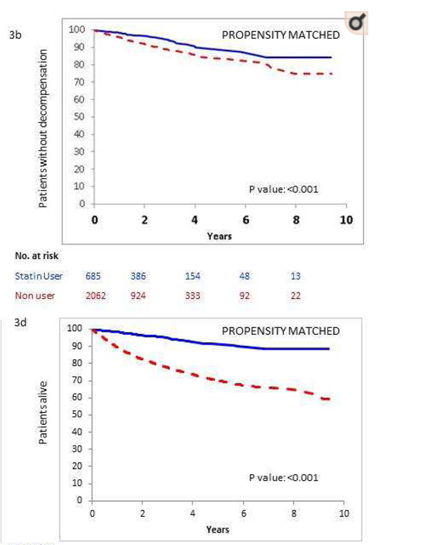
STATINS – clinical studies: Decompensation and death
Statins are Associated with a Decreased Risk of Decompensation and Death in Veterans with Hepatitis C-related Compensated Cirrhosis. Arpan Mohanty, Janet Tate and Guadalupe Garcia-Tsao. Gastroenterology 2016
Retrospective cohort study VA-HCV database
n=40512 pts
Propensity score model new statin users vs non-users
Decompensation
Statin use was associated with:
Lower risk of decompensation HR 0.55 (95% CI 0.39, 0.77)
Lower risk of variceal bleeding HR 0.39 (0.19, 0.78)
Lower risk of ascites HR 0.59 (0.39, 0.91)
Lower risk of death HR 0.56 (0.46, 0.69)
Lower risk of HCC HR 0.42 (0.27, 0.64)
Lower rate of liver transplantation HR 0.37 (0.15, 0.96)
Survival
Notes:
Background & Aims—Statins decrease portal pressure in patients with cirrhosis and increase survival times of those who have bled from varices. However, statins can be hepatotoxic. It is important to determine whether long-term statin use will be beneficial or detrimental for patients with cirrhosis because physicians are reluctant to prescribe statins to patients with liver disease. We investigated effects of statins on decompensation and survival times in patients with compensated cirrhosis.
Methods—We performed a retrospective cohort using the Veteran Affairs Clinical Case Registry, which contains nationwide data from veterans infected with the hepatitis C virus (HCV). We identified patients with compensated cirrhosis from January 1996 through December 2009. Statin use was according to filled prescriptions. Cirrhosis and decompensation were determined from ICD9 codes, using a validated algorithm.
Results—Among 40,512 patients with HCV compensated cirrhosis (98% male, median age of 56 years), 2802 statin users were identified. We developed a propensity score model using variables associated with statin prescription, and new statin users were matched with up to 5 non-users; 685 statin users were matched with 2062 non-users. Discrimination of the propensity score model was 0.92. Statin users had lower risk of decompensation (hazard ratio [HR], 0.55; 95% confidence interval [CI], 0.39–0.77)] and death (HR, 0.56; 95% CI, 0.46–0.69), compared with non-users. Findings persisted after adjustment for age, FIB-4 index score, serum level of albumin, model for end-stage liver disease and Child scores (HR for decompensation, 0.55; 95% CI, 0.39–0.78) and HR for death, 0.55; 95% CI, 0.45–0.68).
Conclusions—Based on data from the Veteran Affairs Clinical Case Registry, statin use among patients with HCV and compensated cirrhosis is associated with over 40% lower risk of cirrhosis decompensation and death. Although statins cannot yet be widely recommended for these patients, their use should not be avoided.

Slide 24
STATINS – clinical studies: Decompensation and death
Statins Decrease the Risk of Decompensation in Hepatitis B Virus– and Hepatitis C Virus–Related Cirrhosis: A Population-Based Study. Fu-Ming Chang, Yen-Po Wang, Hui-Chu Lang, Chia-Fen Tsai, Ming-Chih Hou, Fa-Yauh Lee, and Ching-Liang Lu. Hepatology 2017
Taiwan National Health Insurance cohort - 2000 to 2013
Cirrhotic statin users (≥28 days) vs Non users (propensity score matching) n=1350 pts
Significant dose-dependant lower risk in:
Decompensation HR 0.39
Death HR 0.46
HCC HR 0.42
Compensated cirrhosis
Survival

Slide 25
STATINS – Clinical studies: Infections
Statin use and infections in Veterans with cirrhosis. Motzkus-Feagans C, Pakyz AL, Ratliff SM, Bajaj JS, Lapane KL. Aliment Pharmacol Ther. 2013
n=19379 VA pts with compensated cirrhosis
Propensity score matching of new statin users vs no users or other cholesterol lowering drugs users
12.4% of patients developed a serious infection
Statin users experienced 33% less hospitalisations due to infections than non-users
Other cholesterol lowering drugs also had a protective effect

Slide 26
STATINS – Clinical studies: NAFLD/NASH
Statin use and non-alcoholic steatohepatitis in at risk individuals. P Dongiovanni, Spetta, V Mannisto, RM Mancina, R Pipitone, VM Maggioni, P Kakela, O Wiklund, E Mozzi, S Grimaudo, D Kaminska, R Rametta, A Craxi, S Fargion, V Nobili, S Romeo, J Pihlajamaki, L Valenti. J Hepatol 2015
Multi-center cross-sectional cohort of biopsied individuals
at risk of NASH n=1201 pts
Only 9% in statin treatment
Statin use was associated with reduced risk of: - Steatosis OR 0.48 (0.26– 0.94)
- NASH OR 0.62 (0.40–0.97) - F2-F4 OR 0.59 (0.34–0.98)
Notes:
Background & Aims: Excess hepatic free cholesterol contributes
to the pathogenesis of non-alcoholic steatohepatitis, and statins
reduce cholesterol synthesis. Aim of this study was to assess
whether statin use is associated with histological liver damage
related to steatohepatitis.
Methods: The relationship between statin use, genetic risk factors,
and liver damage was assessed in a multi-center cohort of
1201 European individuals, who underwent liver biopsy for suspected
non-alcoholic steatohepatitis.
Results: Statin use was recorded in 107 subjects, and was associated
with protection from steatosis, NASH, and fibrosis stage
F2-F4, in a dose-dependent manner (adjusted p <0.05 for all). In
100 treated patients matched 1:1 for modality of recruitment,
gender, presence of IFG or type 2 diabetes, PNPLA3 I148M risk
alleles, TM6SF2 E167K variant, age, and BMI, statin use remained
associated with protection from steatosis (OR 0.09, 95% C.I. 0.01–
0.32; p = 0.004), steatohepatitis (OR 0.25, 95% C.I. 0.13–0.47;
p <0.001), and fibrosis stage F2-F4 (OR 0.42, 95% C.I. 0.20–0.8;
p = 0.017). Results were confirmed in a second analysis, where
individuals were matched within recruitment center (p <0.05
for all). The protective effect of statins on steatohepatitis was
stronger in subjects not carrying the I148M PNPLA3 risk variant
(p = 0.02 for interaction), as statins were negatively associated
with steatohepatitis in patients negative (p <0.001), but not in
those positive for the I148M variant (p = n.s.).
Conclusions: Statin use was associated with protection towards
the full spectrum of liver damage in individuals at risk of
non-alcoholic steatohepatitis. However, the I148M PNPLA3 risk
variant limited this beneficial effect.

Slide 27
STATINS – Pleiotropic effects
Clinical research
Randomized controlled trials:
Portal Hypertension
Decompensation (rebleeding)
Survival
Observational Studies
Fibrosis progression
Cirrhosis decompensation
Infection
NAFLD/NASH
Meta-analysis and systematic reviews

Slide 28
STATINS – meta-analysis: Decompensation and death
Beneficial Effects of Statins on the Rates of Hepatic Fibrosis, Hepatic Decompensation, and Mortality in Chronic Liver Disease: A Systematic Review and Meta-Analysis. Kamal S, Khan MA, Seth A, Cholankeril G, Gupta D, Singh U, Kamal F, Howden CW, Stave C, Nair S, Satapathy SK, Ahmed A. Am J Gastroenterol. 2017
Role of statins in chronic liver disease
Included:
1 RCT
9 observational studies
Progression of fibrosis
pooled HR: 0.58 (0.51–0.65)
Progression of fibrosis in HCV
pooled HR: 0.52 (0.37–0.73)
Hepatic decompensation
pooled HR: 0.54 (0.46–0.65)
As the quality (certainty) of
evidence is low, further studies are needed before statins can be routinely recommended
Mortality
pooled HR (observational) 0.67 (0.46–0.98)
HR (RCT): 0.39 (0.15–0.99)
Notes:
Statins may improve outcomes in patients with chronic liver disease (CLD). We conducted a
systematic review and meta-analysis to evaluate the impact of statins in the setting of CLD.
METHODS: We searched several databases from inception to 17 October 2016 to identify comparative studies
evaluating the role of statins in CLD. Outcomes of interest were the associations between statin use
and progression of fi brosis, development of hepatic decompensation in cirrhosis, and mortality
in CLD. Adjusted hazard ratios (HRs) were pooled and analyzed using a random effects model.
Subgroup analyses were performed based on the method of detection for progression of hepatic
fi brosis and quality of studies.
RESULTS: We included 10 studies (1 randomized controlled trial and 9 observational) with 259,453 patients
(54,441 statin users and 205,012 nonusers). For progression of hepatic fi brosis, pooled HR
(95% confi dence interval) was 0.49 (0.39–0.62). On subgroup analysis of studies using ICD-9
(The International Classifi cation of Diseases, Ninth Revision) coding and a second method to detect
cirrhosis, pooled HR was 0.58 (0.51–0.65); pooled HR for studies using ICD-9 coding only was 0.36
(0.29–0.44). For progression of fi brosis in patients with hepatitis C virus (HCV) infection, pooled HR
was 0.52 (0.37–0.73). For hepatic decompensation in cirrhosis, pooled HR was 0.54 (0.46–0.65).
For mortality, pooled HR based on observational studies was 0.67 (0.46–0.98); in the randomized
controlled trial, HR was 0.39 (0.15–0.99). However, the quality of evidence for these associations is
low as most included studies were retrospective in nature and limited by residual confounding.
CONCLUSIONS: Statins may retard the progression of hepatic fi brosis, may prevent hepatic decompensation in
cirrhosis, and may reduce all-cause mortality in patients with CLD. As the quality (certainty) of
evidence is low, further studies are needed before statins can be routinely recommended.

Slide 29
STATINS – Clinical studies: HCC
Statins are associated with a reduced risk of hepatocellular cancer: a systematic review and meta-analysis. Singh S, Singh PP, Singh AG, Murad MH, Sanchez W. Gastroenterology 2013
Role of statins in HCC incidence
Included:
3 RCT
3 case-control studies
4 cohort studies
Risk of HCC
Statin users adjusted OR 0.63
(sign. Heterog)
NNT in Asian population
5209 pts:1 HCC case prevention
In HBV East-Asian males: 57 pts: 1 HCC
Notes:
Hepatocellular carcinoma
(HCC) is a leading cause of cancer-related mortality
worldwide. Several studies have shown that statins could
have chemopreventive effects on HCC. We performed a
systematic review and meta-analysis of studies that eval-
uated the effects of statins on the risk of HCC. METH-
ODS: We conducted a systematic search of MEDLINE,
Embase, and Web of Science through May 2012 and
manually reviewed the literature. Studies were included if
they evaluated and clearly defined exposure to statins,
reported the incidence of HCC, and reported relative risks
or odds ratios (ORs) or provided data for their estimation.
Ten studies reporting 4298 cases of HCC in 1,459,417
patients were analyzed. Summary OR estimates with 95%
confidence intervals (CIs) were calculated using the ran-
dom effects model. Statistical heterogeneity was assessed
with the Cochran’s Q statistic and I2 statistic. RESULTS:
Statin users were less likely to develop HCC than statin
nonusers (adjusted OR, 0.63; 95% CI, 0.52– 0.76), al-
though the results were heterogeneous (P .01, I2
59%). This heterogeneity could be accounted for by study
location (Asian population [n 4]: adjusted OR, 0.52;
95% CI, 0.42– 0.64; Western population [n 6]: adjusted
OR, 0.67; 95% CI, 0.53– 0.85) and design (observational
studies [n 7]: adjusted OR, 0.60; 95% CI, 0.49 – 0.73;
clinical trials [n 3]: adjusted OR, 0.95; 95% CI, 0.62–
1.45). CONCLUSIONS: Based on meta-analysis, statin
use is associated with a reduced risk of HCC, most
strongly in Asian but also in Western populations.
Randomized clinical trials in populations at high risk
for HCC (especially in Asian populations with hepa-
titis B) are warranted.

Slide 30
STATINS – Pleiotropic effects
Clinical research
Randomized controlled trials:
Portal Hypertension
Decompensation (rebleeding)
Survival
Observational Studies
Fibrosis progression
Cirrhosis decompensation
Infection
NAFLD/NASH
Meta-analysis and systematic reviews
Safety

Slide 31
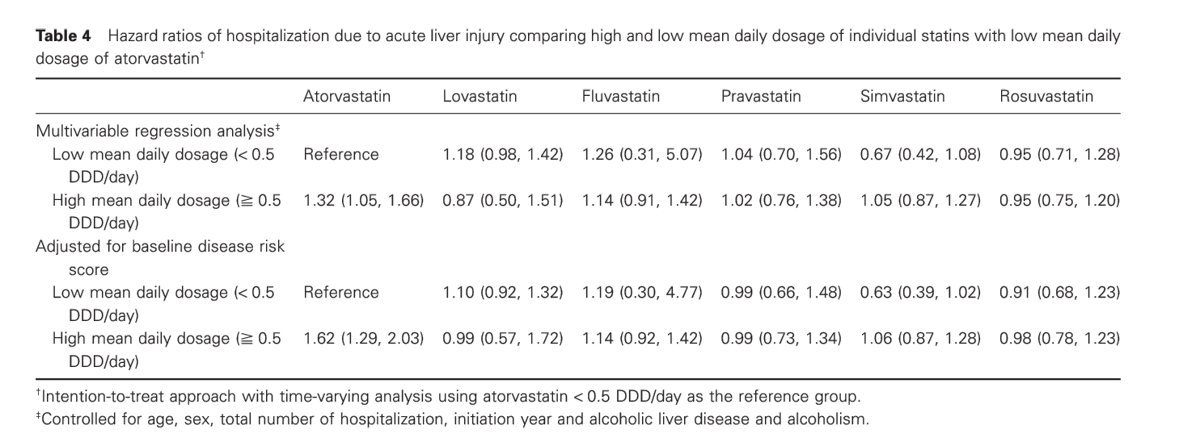
STATINS – Safety
Severe hepatic injury associated with different statins in patients with chronic liver disease: A nationwide population-based cohort study. Chia-Hsuin Chang, Yi-Cheng Chang, Yen-Chieh Lee, Ying-Chun Liu, Lee-Ming Chuang and Jou-Wei Lin.
Population-based cohort study - Taiwan National HI database
n=37 929 CLD pts who started statin 2005 - 2009 Outcome: hospitalization due to liver injury
Only high mean daily dose of atorvastatin (≧ 0.5 DDD) was associated with a significantly higher risk of hospitalization due to DILI
Incidence of DILI: similar in all statin groups (1.94 to 2.95 per 100 000 person-days)
Notes:
Background and Aim: The hepatotoxicity of statins in patients with chronic liver diseases
remains unclear. In this study, we aimed to estimate the risk of severe hepatic injury
associated with different statins in patients with chronic liver disease.
Methods: A nationwide population-based cohort study was conducted by analyzing the
Taiwan National Health Insurance database. A total of 37 929 subjects with chronic liver
disease who started statin therapy were identified during the period of January 1, 2005 to
December 31, 2009. Outcome was defined as hospitalization due to liver injury.
Results: During a total of 118 772 person-years of follow-up, 912 incident cases of
hospitalization due to hepatic injury are identified. The incidence rate was 2.95, 2.49, 2.92,
1.94, 2.65, and 2.52 per 100 000 person-days for atorvastatin, lovastatin, fluvastatin,
pravastatin, simvastatin, and rosuvastatin initiators, respectively. Overall, there was no
difference in the incidence associated with different statins. However, when each statin was
further categorized to high (≧ 0.5 defined daily dose) or low (< 0.5 defined daily dose)
mean daily dose, only high-dose atorvastatin was significantly associated with increased
risk of hospitalization due to hepatic injury (hazard ratio, 1.62; 95% confidence interval,
1.29, 2.03) as compared with low-dose atorvastatin.
Conclusion: The overall incidence of hospitalization due to severe hepatic injury was low
among statin initiators with chronic liver disease. Only high-dose atorvastatin was associated
with increased risk

Slide 32
STATINS – Safety
An assessment by the Statin Liver Safety Task Force: 2014 update. Harold Bays, MD, FNLA, David E. Cohen, MD, PhD, Naga Chalasani, MBBS, Stephen A. Harrison. Journal of Clinical Lipidology (2014)
Impared liver function alters pharmacokinetics and drug exposure! Weersink RA et al. Gastroenterol 2016

Slide 33
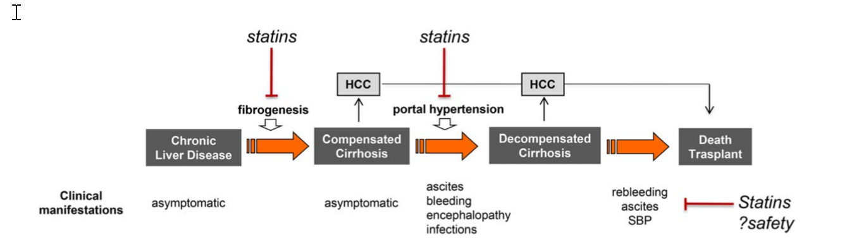
Conclusions
Tsochatzis, Bosch. Hepatology 2017
There is growing evidence that statins have benefitial effects such as reduction in portal pressure, improved liver sinusoidal dysfunction, decreased fibrogenesis, protection against ischemia/reperfusion and shock related injury, improvement in liver graft preservation, protection from acute-on-chronic liver failure (ACLF), decreased risk of HCC and preventing/delaying progression of cirrhosis of any etiology.
However, further RCTs are required, with larger patient series and hard clinical end-points, before statins can be recommended for use in patients with chronic liver disease.

Slide 34

Trials Ongoing – Statins and HCC
Simvastatin in Preventing Liver Cancer in Patients With Liver Cirrhosis
OBJECTIVES:
To evaluate the effect of a simvastatin intervention versus placebo on the change in serum AFP-L3% from baseline to 6 months following treatment initiation in patients with liver cirrhosis who have a current model for end-stage liver disease (MELD) =< 20. PI: Marc Goodman (Cedars Sinai)
RCT 80 pts – end 2020 (NCT02968810)
Statin for Preventing Hepatocellular Carcinoma Recurrence After Curative Treatment (SHOT)
Objectives: 3-year cumulative incidence of recurrent HCC between the intervention group and control
Atorvastatin vs placebo
PI: Po Yueh Chen, Chia Yi Christian Hospital, Taiwan
RCT 240 pts – end January 2022 – (NCT03024684)
Statin Combination Therapy in Patients Receiving Sorafenib for Advanced Hepatocellular Carcinoma
Objectives: Overall survival [ Time Frame: Three year ]
Atorvastatin vs placebo
PI: Teng Yu Lee, Taichung Veterans General Hospital, Taiwan
RCT 200 pts – end January 2023 – (NCT03275376)

Slide 35
Trials Ongoing – Statins and NAFLD
A Randomized, Prospective, Open Label, Active Control, Phase IV Study to Evaluate the Effects of Statin Monotherapy or Statin / Ezetimibe Combination Therapy on Hepatic Steatosis in Patients With Hyperlipidemia and Nonalcoholic Fatty Liver Disease. NCT03434613
Objectives: compare the difference of liver fat change measured by MRI-PDFF in localized regions of interest within nine liver segments between two groups treated with rosuvastatin 5mg and rosuvastatin 5mg / ezetimibe 10mg combination therapy patients with hyperlipidemia and fatty liver disease. PI: Yong-ho Lee, Yonsei University Korea
RCT single institution 70 patients – 6 months
Atorvastatin, L-Carnitine and Non-Alcoholic Steatohepatitis (NALCAT)
NCT01617772
Objectives: improvement in liver stiffness in 2 years as measured by Fibroscan, improvement in liver enzyme levels in 2 years and difference between last and first measurements in NASH patients
RCT 440 patients – randomized asigment to atorvastatin, L-Carnitine or Placebo
PI: Shahin Merat, Tehran University of Medical Sciences

Slide 36

Trials Ongoing – Statins and Liver Transplantation
The addition of simvastatin administration to cold storage solution of explanted whole liver grafts for facing ischemia/reperfusion injury in an area with a low rate of deceased donation: A monocentric randomized controlled double-blinded phase 2 study. Pagano, D, Gruttadauria, S et al. BMC Surgery, 2018
Population: Organs procured in a DBD after preoperative administration of Simvastatin vs placebo. Outcome: postoperative graft survival after LT. RCT 106 pts
Registered: ISRCTN27083228.
Trials Ongoing – Statins safety
Liver Injury by Statins in Patients With History of Hepatitis B Virus Infection (LISHBV)
Objectives: to investigate the incidence of liver injury by statins in coronary heart disease (CHD) patients with history of hepatitis B virus (HBV) infection. PI: Zhijian Yang, Doctor. First Affiliated Hospital of Nanjing Medical University, China.
RCT 600 pts – end 2020
Trials Ongoing – Statins and cirrhosis decompensation
Statins And Cirrhosis: Reducing Events of Decompensation (SACRED)
Objectives: whether simvastatin can lower the risk of hepatic decompensation in U.S. Veterans who have compensated cirrhosis PI:Tamar Taddei, VA Connecticut Healthcare System
Phase III RCT 500 pts – end 2023

Slide 37





Thank you!!

