Slide 1
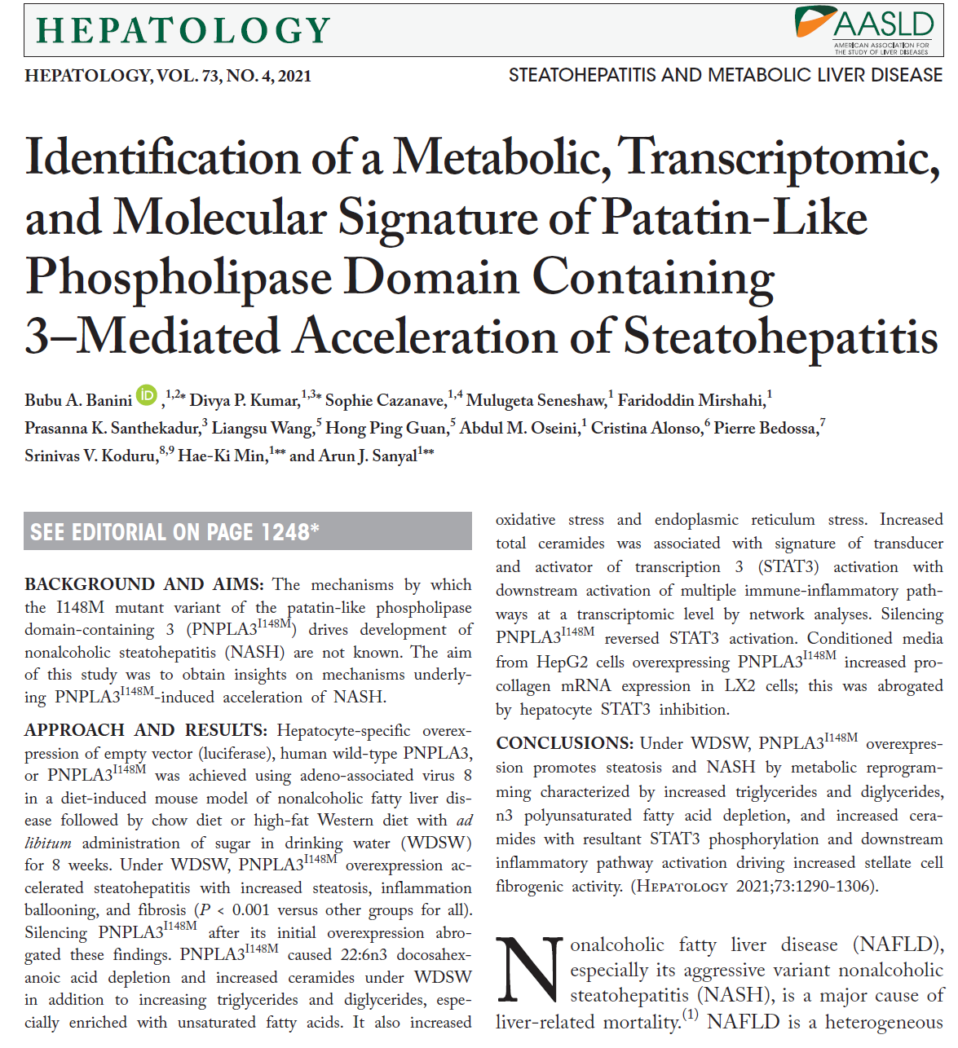
Journal club on July 29, 2021
Patcharamon Seubnooch, PhD Candidate
Department for BioMedical Research, Hepatology
University of Bern, Switzerland

Slide 2
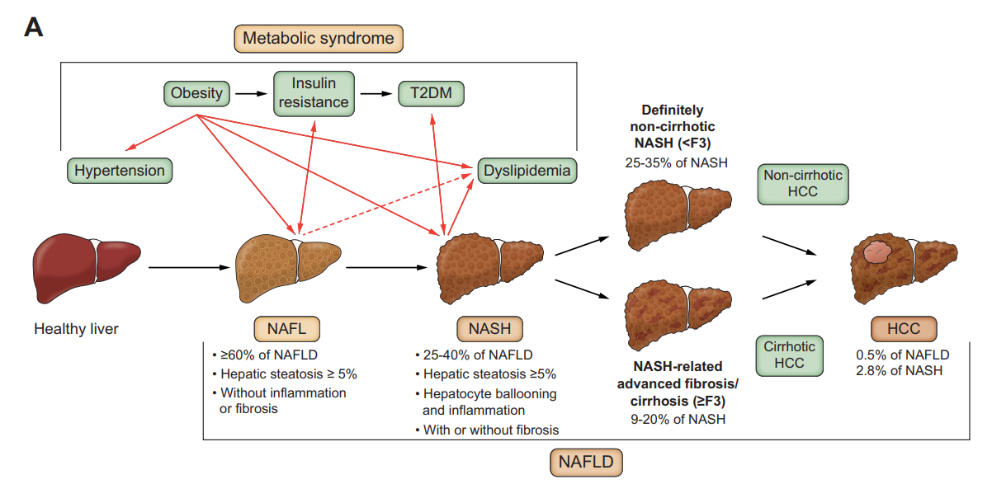
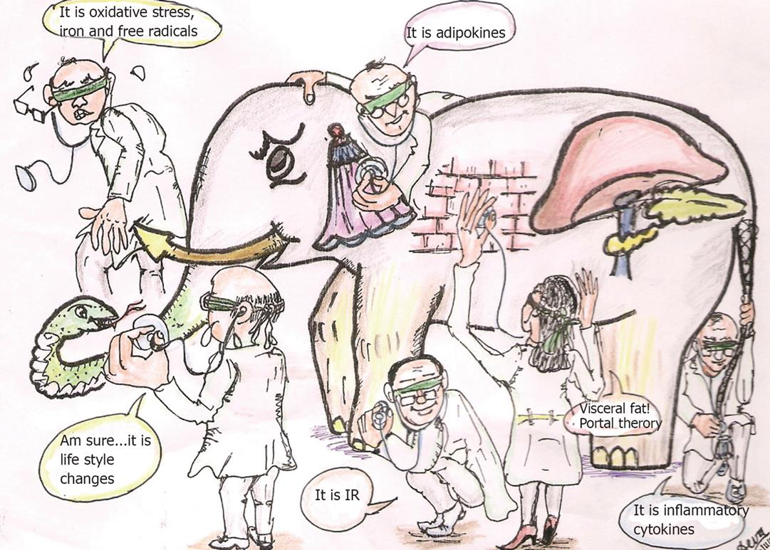
Nonalcoholic fatty liver disease (NAFLD)
NAFLD is a heterogeneous disorder driven by complex gene–environment interactions that produce variable clinical and histological phenotypes of the disease that progress at variable rates toward cirrhosis.
Kucukoglu, O. et al. J Hepatol. 2021
NAFLD
Understanding the basis for such heterogeneity is critical for development of highly effective therapeutics for affected individuals.
Sanal, MG. World J Gastroenterol. 2008

Slide 3
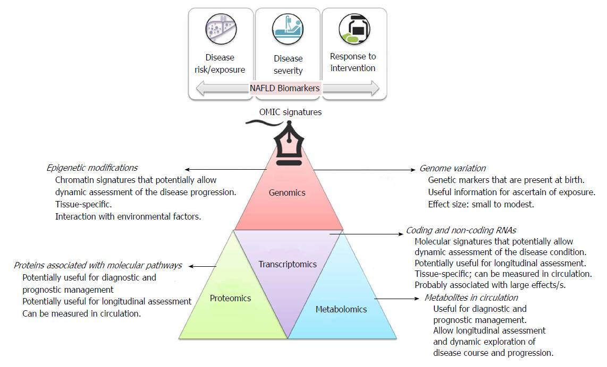
OMICs knowledge in the field of NAFLD
Pirola, CJ and Sookoian, S. World J Gastroenterol. 2018

Slide 4
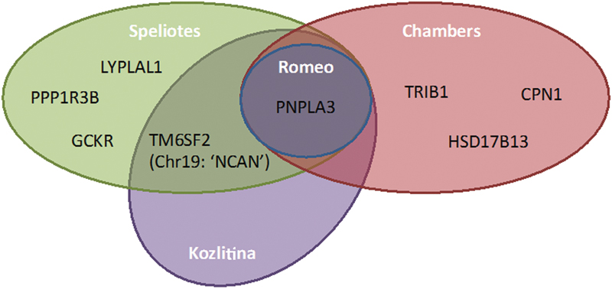
Commonality between the largest genome-wide association studies (GWASs) in NAFLD
Commonality between the largest GWASs in NAFLD, showed commonality in genes identified in GWASs examining aspects of the NAFLD phenotype.
Currently, only two genes (PNPLA3 and TM6SF2) have been identified in more than one study.
PNPLA3 gene was the first major gene associated with NASH
Anstee, Q.M. and Day, C.P. Semin Liver Dis 2015

Slide 5
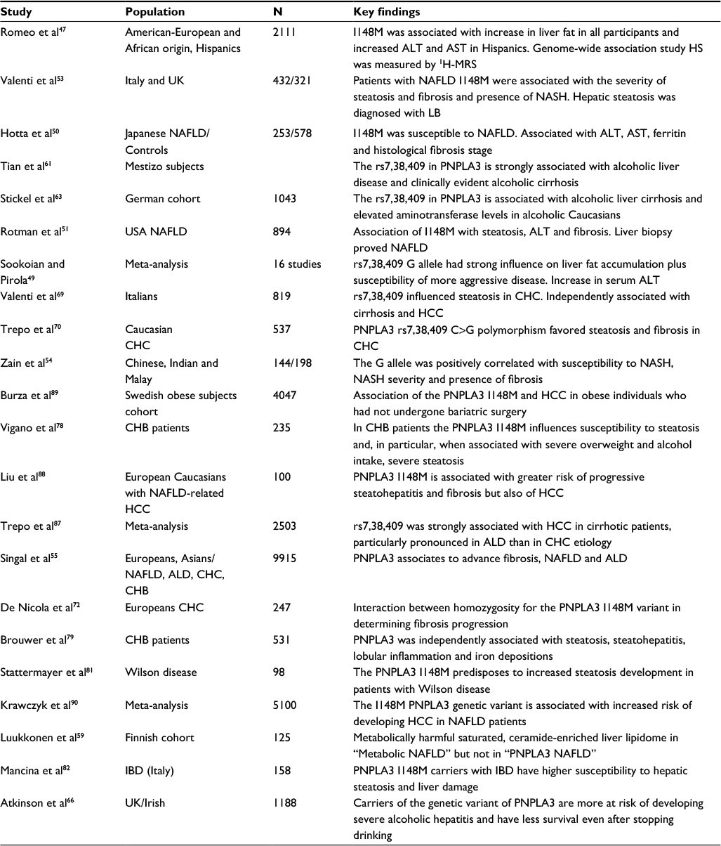
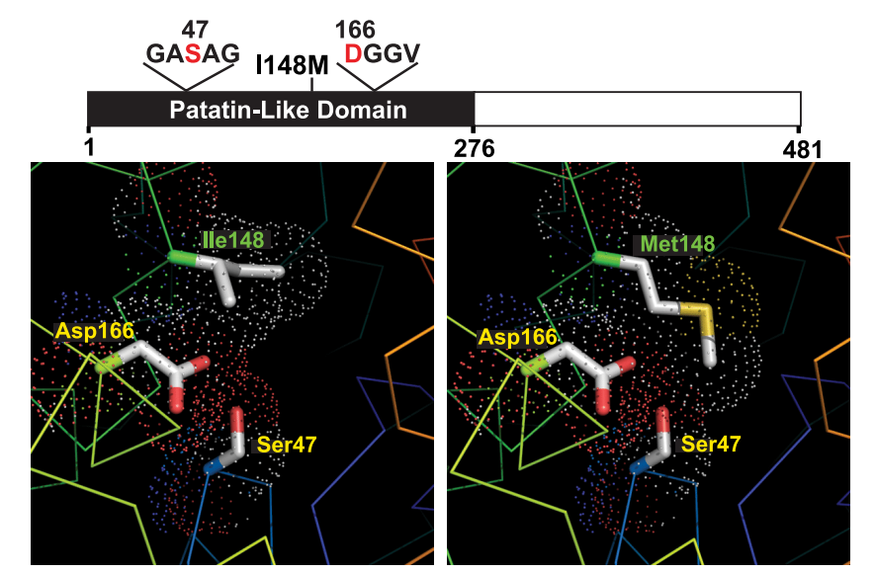
The patatin-like phospholipase domain containing 3 (PNPLA3) gene
In 2008, a GWAS study of the Dallas Heart Study cohort, where hepatic liver fat content was measured by magnetic spectroscopy, identified a significant association between PNPLA3 rs738409 C>G mutation, encoding an isoleucine to methionine substitution at amino acid position 148 (I148M) and NAFLD, independent of BMI, diabetes, and alcohol use.
Whole-genome scan of liver triglyceride content measured by proton magnetic resonance imaging in the Dallas Heart Study (n=2,111).
(a) Quantile-quantile plot of P-values. (b) Scatter plot of P-values. The dashed line denotes the Bonferroni corrected significance threshold (P=5.4×10⁻⁶).
Romeo, S. et al. Nat Genet. 2008
Bruschi, F. V. et al. Hepatic Medicine: Evidence and Research. 2017
He, S. et al. J Biol Chem. 2010

Slide 6
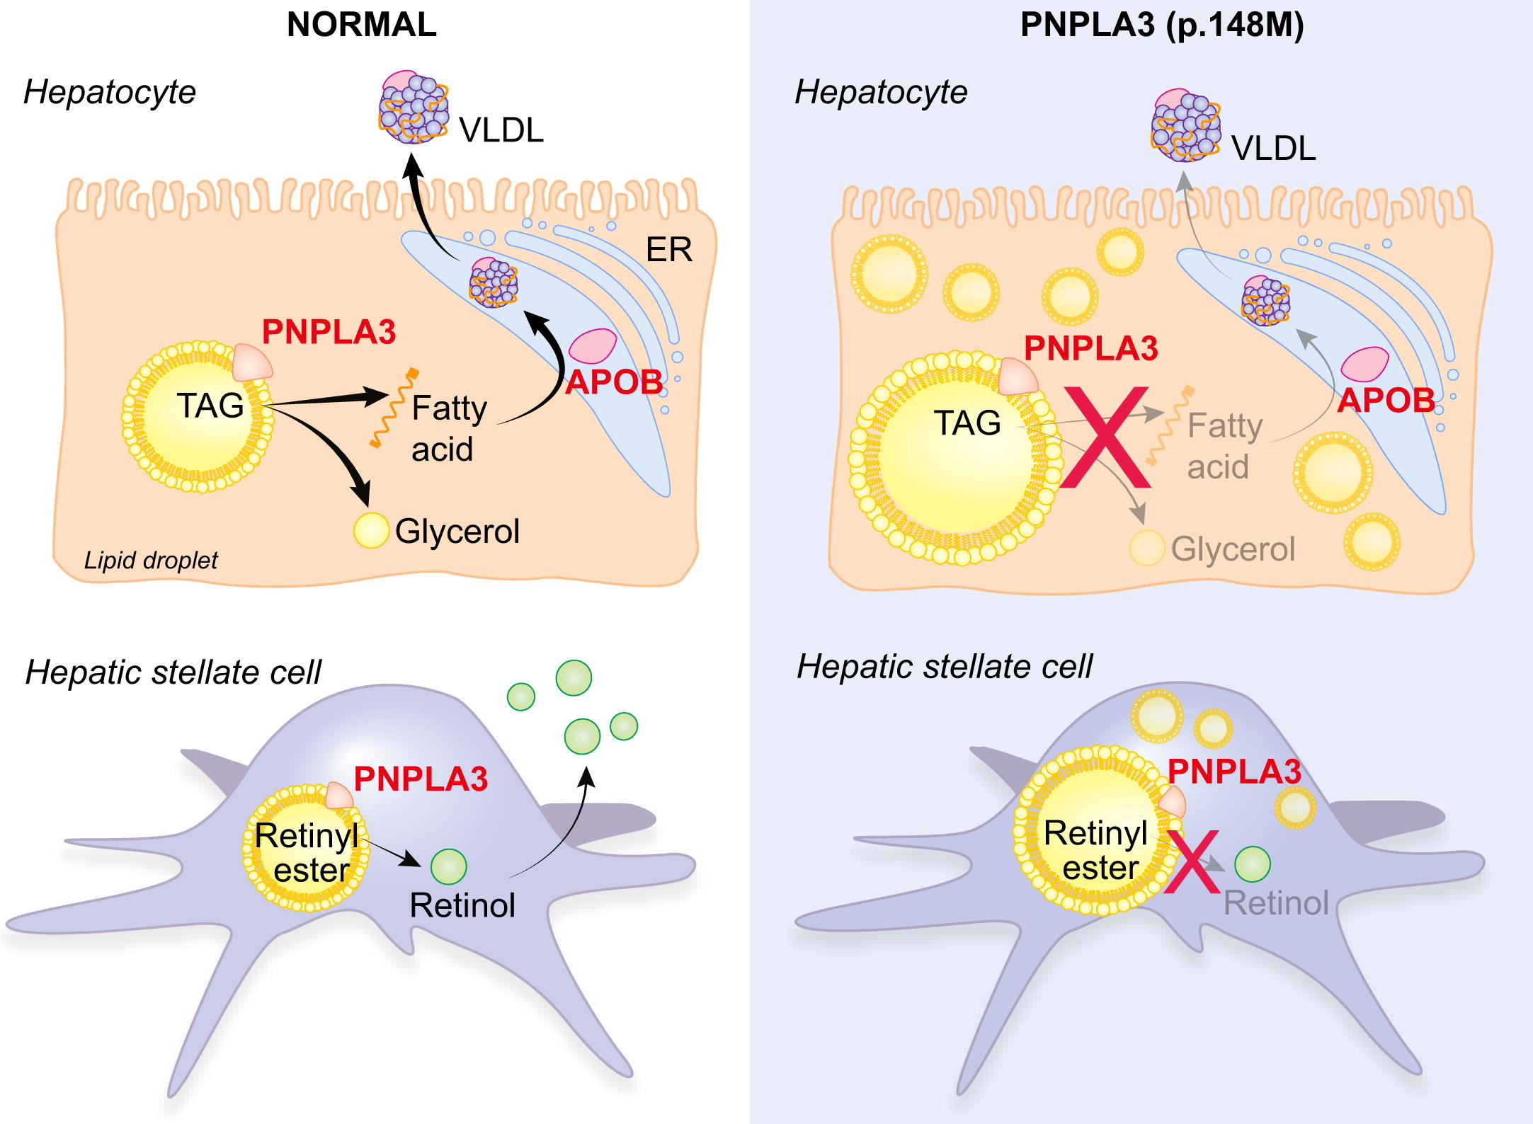
PNPLA3^{I148M} gene
PNPLA3 is highly expressed in human hepatic stellate cells and hepatocytes.
In both cells this protein is located in lipid droplets and it has hydrolase activity towards triglycerides and retinyl esters in hepatocytes and hepatic stellate cells, respectively.
The I148M mutation results in loss of function of the protein with liver fat retention in hepatocytes and retinol retention in hepatic stellate cells.
Overexpression of human PNPLA3^{I148M}
Trépo, E. et al. J Hepatol. 2016

Slide 7
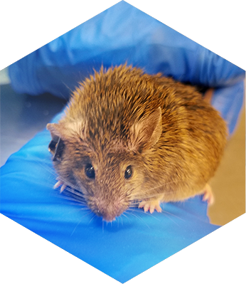
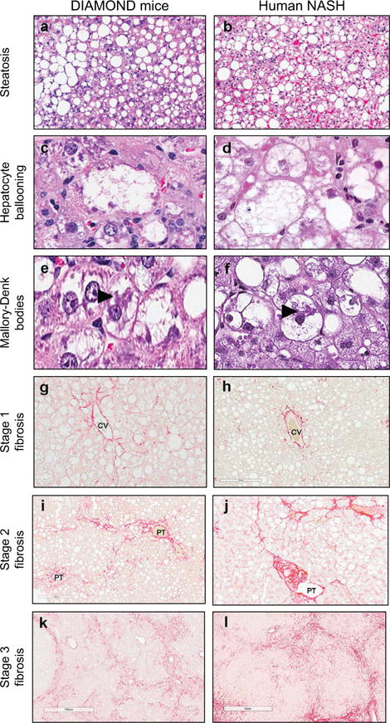
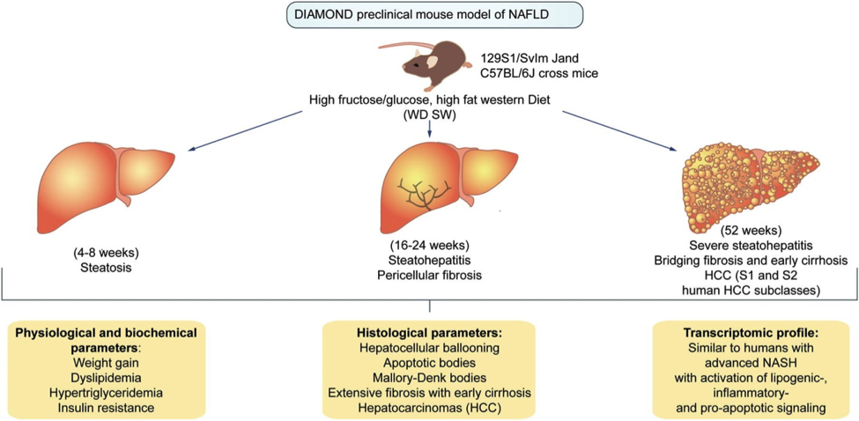
DIAMOND: A diet-induced mouse model of non-alcoholic steatohepatitis
DIAMOND mouse
This model mimics all the physiological, metabolic, histological, transcriptomic gene signature and clinical endpoints of human NASH and can facilitate preclinical development of therapeutic targets for NASH.
Main histological features of DIAMOND mice are comparable to human NASH
Asgharpour, A. et al. J Hepatol. 2016

Slide 8
PNPLA3 mediated acceleration of Steatohepatitis
DIAMOND mouse
AAV-luciferase (Luc)
To test the hypothesis that overexpression of PNPLA3^{I148M} would cause development of NASH with fibrosis at a time point (8 weeks) when the model would normally only develop a fatty liver, thus demonstrating disease acceleration by PNPLA3^{I148M}
To confirm the specificity of these findings by rescuing the phenotype by silencing PNPLA3^{I148M} after its initial overexpression
To define the metabolomic, transcriptomic, and molecular bases of PNPLA3^{I148M}-related acceleration of steatohepatitis and fibrosis
To confirm the effects of hepatocyte-specific PNPLA3 expression on stellate cell activation, procollagen gene expression in stellate cells was measured after exposure to conditioned media from hepatocytes with and without overexpressed PNPLA3^{I148M}
AAV-PNPLA3^{WT}
CDNW
WDSW
AAV-PNPLA3^{I148M}
CDNW
WDSW
CDNW
WDSW
CDNW: chow diet/normal water
WDSW: high-fat western diet/sugar water

Slide 9
PNPLA3 mediated acceleration of Steatohepatitis
DIAMOND mouse
AAV-luciferase (Luc)
To test the hypothesis that overexpression of PNPLA3^{I148M} would cause development of NASH with fibrosis at a time point (8 weeks) when the model would normally only develop a fatty liver, thus demonstrating disease acceleration by PNPLA3^{I148M}
To confirm the specificity of these findings by rescuing the phenotype by silencing PNPLA3^{I148M} after its initial overexpression
To define the metabolomic, transcriptomic, and molecular bases of PNPLA3^{I148M}-related acceleration of steatohepatitis and fibrosis
To confirm the effects of hepatocyte-specific PNPLA3 expression on stellate cell activation, procollagen gene expression in stellate cells was measured after exposure to conditioned media from hepatocytes with and without overexpressed PNPLA3^{I148M}
AAV-PNPLA3^{WT}
CDNW
WDSW
AAV-PNPLA3^{I148M}
CDNW
WDSW
CDNW
WDSW
CDNW: chow diet/normal water
WDSW: high-fat western diet/sugar water
scrambled siRNA
PNPLA3^{I148M} siRNA

Slide 10
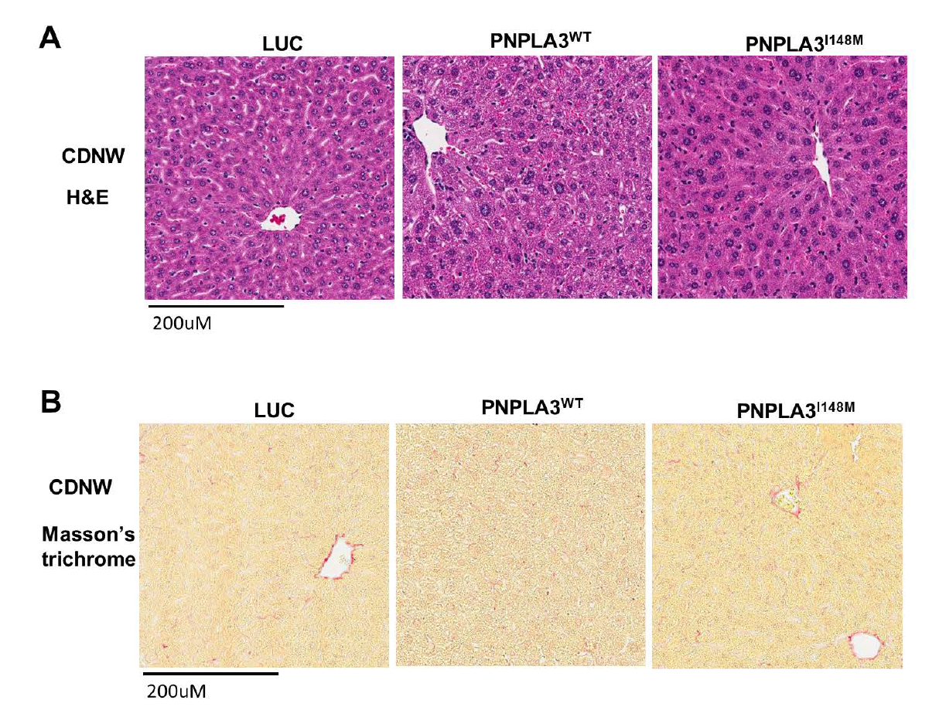
PNPLA3^{I148M} expression aggravates steatohepatitis and fibrosis
Whereas Luc and PNPLA3^{WT} mice had a fatty liver, PNPLA3^{I148M} mice developed steatohepatitis with fibrosis.
#P < 0.05 compared to LUC on WDSW, *P < 0.05 compared to PNPLA3^{WT} on WDSW
¥P < 0.05 compared to scrambled siRNA-PNPLA3^{I148M}
In comparison to PNPLA3^{I148M} mice that received scrambled siRNA, those with PNPLA3^{I148M} silencing showed decreased steatosis and lobular inflammation, whereas ballooning disappeared entirely and the fibrosis score was decreased

Slide 11
Summary
The current study provides proof of concept that NASH with fibrosis can be accelerated by PNPLA3^{I148M} but only under conditions of a WDSW diet.
This gene-environment interaction leads to metabolic reprogramming, particularly affecting the PUFA and sphingolipid metabolic pathways with downstream activation of inflammatory and cell injury pathways, especially through STAT3 activation.
The last demonstrate the ability of hepatocyte overexpression of PNPLA3^{I148M} to activate stellate cells.

Slide 12
PNPLA3 mediated acceleration of Steatohepatitis
DIAMOND mouse
AAV-luciferase (Luc)
To test the hypothesis that overexpression of PNPLA3^{I148M} would cause development of NASH with fibrosis at a time point (8 weeks) when the model would normally only develop a fatty liver, thus demonstrating disease acceleration by PNPLA3^{I148M}
To confirm the specificity of these findings by rescuing the phenotype by silencing PNPLA3^{I148M} after its initial overexpression
To define the metabolomic, transcriptomic, and molecular bases of PNPLA3^{I148M}-related acceleration of steatohepatitis and fibrosis
To confirm the effects of hepatocyte-specific PNPLA3 expression on stellate cell activation, procollagen gene expression in stellate cells was measured after exposure to conditioned media from hepatocytes with and without overexpressed PNPLA3^{I148M}
AAV-PNPLA3^{WT}
CDNW
WDSW
AAV-PNPLA3^{I148M}
CDNW
WDSW
CDNW
WDSW
CDNW: chow diet/normal water
WDSW: high-fat western diet/sugar water

Slide 13
Mechanisms underlying PNPLA3^{I148M}-associated acceleration of NASH and Fibrosis
An integrated pathway analysis including both differentially expressed genes and metabolites was performed to identify the metabolic reprogramming signature of PNPLA3^{I148M}.
These confirmed that the main impact attributable to mutation of the PNPLA3 gene was a metabolic reprogramming with main effects on the PUFA, glutathione, and sphingolipid pathways.

Slide 14
Metabolic Reprogramming Due to PNPLA3^{I148M} Overexpression
Effect on fatty acid metabolism
PNPLA3^{I148M} caused 22:6n3 docosahexanoic acid depletion in addition to increasing TAGs and DAGs, especially enriched with unsaturated fatty acids.
arachidonic acid
linolenic acid
DHA: docosahexanoic acid
arachidonic acid
linolenic acid
DHA: docosahexanoic acid
DHA: docosahexanoic acid
#P < 0.05 compared to LUC on the same diet, *P < 0.05 compared to PNPLA3^{WT} on the same diet.

Slide 15
PNPLA3^{I148M} up-regulates ceramide signaling
Effect on Sphingolipid metabolism
PNPLA3^{I148M} on WDSW demonstrating significantly increased total ceramides including unsaturated and saturated ceramides compared to other groups.
The differences in ceramides and sphingomyelins based on both diet and PNPLA3 status.
#P < 0.05 compared to LUC
*P < 0.05 compared to PNPLA3^{WT}, ¥P < 0.05 compared PNPLA3^{I148M}
PNPLA3^{I148M} overexpression increased expression of multiple genes in the ceramide synthesis, sphingomyelin, and salvage pathways
Silencing PNPLA3^{I148M} resulted in down-regulation of these genes, indicating that the observed increments were linked to PNPLA3^{I148M}

Slide 16
Mutant PNPLA3 impacts key cellular processes and promotes cell death
PNPLA3^{I148M} expression was also associated with several markers of the unfolded protein response including GRP78, ATF4, CHOP, and JNK.
This was associated with modestly increased apoptosis.
PNPLA3^{I148M} expression resulted in increased oxidative stress as evidenced by accumulation of oxidized glutathione, increased oxidized eicosanoids, superoxide dismutase and Nrf2 expression

Slide 17
PNPLA3^{I148M} on a high-fat diet differentially up-regulates innate immune system and inflammatory pathways
The top innate immune pathways that were activated demonstrated transcriptomic activation of the JAK–STAT system.
JAK and STAT3 activation were further confirmed by western blot, and its relationship to PNPLA3^{I148M} was confirmed by its deactivation upon silencing the gene.
Pathway analysis also revealed numerous targets of STAT3, well known to be activated by increased ceramides, that were also activated and linked to the transcriptomic inflammatory response to PNPLA3^{I148M}.
Integrated pathway analysis revealed a strong signature of ceramide-related inflammatory activation including H-ras and downstream phospholipase A2 activation.

Slide 18
Summary
The current study provides proof of concept that NASH with fibrosis can be accelerated by PNPLA3^{I148M} but only under conditions of a WDSW diet.
This gene-environment interaction leads to metabolic reprogramming, particularly affecting the PUFA and sphingolipid metabolic pathways with downstream activation of inflammatory and cell injury pathways, especially through STAT3 activation.
The last demonstrate the ability of hepatocyte overexpression of PNPLA3^{I148M} to activate stellate cells.

Slide 19
PNPLA3 mediated acceleration of Steatohepatitis
DIAMOND mouse
AAV-luciferase (Luc)
To test the hypothesis that overexpression of PNPLA3^{I148M} would cause development of NASH with fibrosis at a time point (8 weeks) when the model would normally only develop a fatty liver, thus demonstrating disease acceleration by PNPLA3^{I148M}
To confirm the specificity of these findings by rescuing the phenotype by silencing PNPLA3^{I148M} after its initial overexpression
To define the metabolomic, transcriptomic, and molecular bases of PNPLA3^{I148M}-related acceleration of steatohepatitis and fibrosis
To confirm the effects of hepatocyte-specific PNPLA3 expression on stellate cell activation, procollagen gene expression in stellate cells was measured after exposure to conditioned media from hepatocytes with and without overexpressed PNPLA3^{I148M}
AAV-PNPLA3^{WT}
CDNW
WDSW
AAV-PNPLA3^{I148M}
CDNW
WDSW
CDNW
WDSW
CDNW: chow diet/normal water
WDSW: high-fat western diet/sugar water

Slide 20
PNPLA3^{I148M}-related hepatocellular injury can activate Stellate cells
Procollagens I and III and α-smooth muscle actin mRNA were all activated in PNPLA3^{I148M}.
Together with increased TGF-β1 protein levels and activation of several known fibrogenic pathways.
To further determine crosstalk between hepatocytes overexpressing PNPLA3^{I148M} and stellate cells, PNPLA3 gene expression was induced by glucose exposure in HepG2 cells, which are known to express PNPLA3^{I148M}
Conditioned media from these cells significantly increased procollagen I and III mRNA expression by LX2 cells.
This experiment was repeated after inhibition of STAT3 in HepG2 cells, resulting in a STAT3 inhibition dose-dependent decrease in procollagen and TGF-β1 mRNA.

Slide 21
Summary
The current study provides proof of concept that NASH with fibrosis can be accelerated by PNPLA3^{I148M} but only under conditions of a WDSW diet.
This gene-environment interaction leads to metabolic reprogramming, particularly affecting the PUFA and sphingolipid metabolic pathways with downstream activation of inflammatory and cell injury pathways, especially through STAT3 activation.
The last demonstrate the ability of hepatocyte overexpression of PNPLA3^{I148M} to activate stellate cells.

Slide 22
ขอบคุณ

