Slide 1
Journal Club 7.3.2019
Florin Gebhart
Notes:
Hinweis zur Bearbeitung von PowerPoint-Vorlagen: Erstellen einer neuen Präsentation stets über: Start → Neue Folie → Master Titel oder Master Inhalt einfügen. Präsentationsinhalte anschliessend in leeren Vorlagen erstellen und bearbeiten. Die übrigen angezeigten Folien nicht für Präsentationsinhalte bearbeiten und am Ende herauslöschen.
Weitere, spezifische Vorlagen im Online Handbuch zum CI/CD:
https://insel.frontify.com/document/22#/office-vorlagen/powerpoint-vorlagen
Weiterführende Infos zum CI/CD inkl. Login-Angaben zum Online-Handbuch: http://netz.insel.ch/de/news/article/2018/08/23/handbuch-zum-ueberarbeiteten-corporate-design-tutorial-teil-2/nocache/1/)

Slide 2
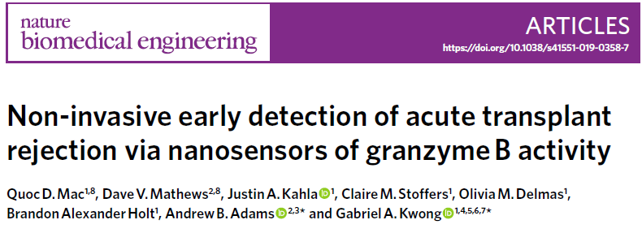
Published 18th february 2019

Slide 3
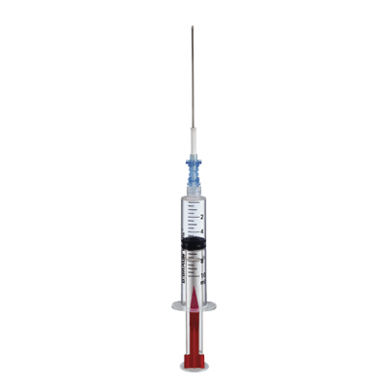
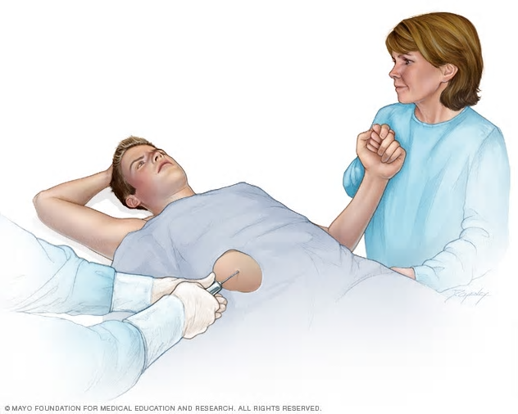
Background 1
Early detection of transplant rejection is critical for long-term survival
Diagnostic gold standard: core biopsy
Notes:
The early detection of the onset of transplant rejection is critical for the long-term survival of patients. The diagnostic gold
standard for detecting transplant rejection involves a core biopsy, which is invasive, has limited predictive power and carries a
morbidity risk.

Slide 4
Background 2
Non-invasive markers
Kidney: BUN, serum kreatinine
Heart: cell free donor DNA
Liver: ALAT, ASAT, GGT, Bili
Notes:
Noninvasive approaches include measuring biomarkers that indicate
organ dysfunction, such as blood urea nitrogen (BUN) and
serum creatinine for kidney allografts or biomarkers associated
with allograft cell death, such as cell-free donor-derived DNA from
the blood of heart transplant patients11. These biomarkers indicate
graft health at a stage of rejection when organ dysfunction or damage
is clinically apparent.
Leber: However, these abnormalities are neither sensitive nor specific for distinguishing acute cellular rejection from other causes of hepatic allograft dysfunction and do not correlate with the severity of the rejection episode. Abnormalities in the hepatic biochemical tests in the short-term post-transplantation period are frequently a manifestation of preservation injury or acute cellular rejection.

Slide 5
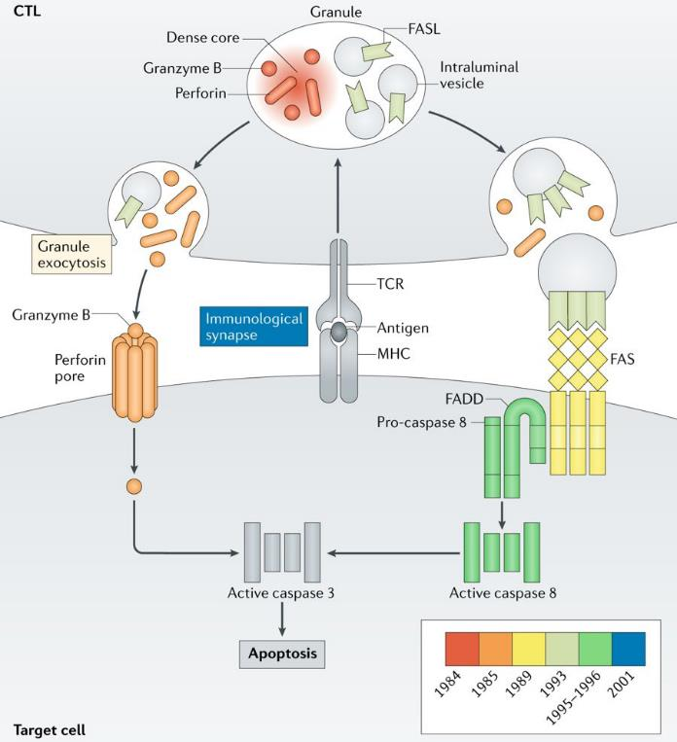
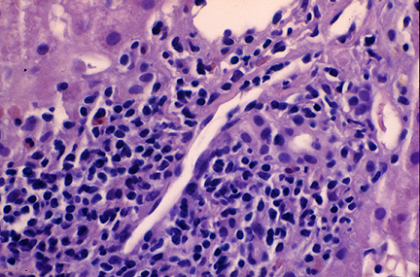
Background 3
Acute cellular rejection (ACR), graft damage is mediated by recipient cytotoxic CD8+ T cells
$
Pierre Golstein, Nature Reviews Immunology, 2018
Notes:
The mechanism by which activated cytotoxic T cells engage and
kill target cells is well studied and involves the release of cytolytic
granules containing perforin, which forms pores in target cell membranes,
and granzymes, which are serine proteases, to trigger apoptosis
by cleavage of caspases or activation of mitochondria and DNA
damage pathways
Early-onset ACR or subclinical ACR, defined
according to Banff stages IA and IB of T-cell-mediated rejection
(TCMR), have been directly shown to correlate to increased granzyme
B (GzmB) expression13–15. In renal allografts, the level of
GzmB+ lymphocytes are significantly higher in stages IA and IB
compared to control biopsies13,14, and predict rapid progression to
severe ACR (TMCR grade II or higher)13.

Slide 6
Study goals
Method for non-invasive detecting GzmB activity as an early indicator for ACR
Design and administration of an engineered agent for investigation diseased tissue
Testing in vivo model (mice) with induced rejection in skin allograft

Slide 7
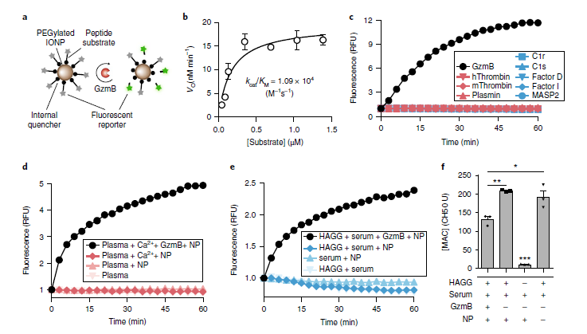
Method 1: The probe
Notes:
1a. nanosensors are formulated by conjugating GzmB peptide
substrates to the surface of a nanoparticle scaffold (Fig. 2a).
A nanoparticle carrier extends the circulation half-life of GzmB
peptide substrates, which would otherwise
be rapidly filtered into urine, and increases peptide accumulation
in tissues by passive diffusion from the circulating vasculature.
2a. To determine cleavage efficiency of peptide substrates conjugated
to a nanoparticle, we conducted Michaelis–Menten kinetic analysis
and calculated a kcat/KM value of 1.09 × 104 M−1 s−1. This value was
similar in magnitude to reported values of GzmB cleavage of free
substrates (Fig. 2b)37,40 and showed that co-presentation of substrates
and PEG molecules on the surface of
IONPs did not sterically hinder GzmB cleavage.
1c., To assess substrate specificity for GzmB they exposed our probes to coagulation and
complement proteases, as they are ubiquitous and found at high concentrations
in circulating blood. Using saline samples spiked with
recombinant proteases (Fig. 2c), plasma samples spiked with Ca2+
to trigger coagulation (Fig. 2d and Supplementary Fig. 5), or heat
aggregated ɣ-globulin (HAGG) to trigger complement (Fig. 2e,f),
we did not observe detectable increases in fluorescence that would
indicate cross-cutting of our probes.

Slide 8
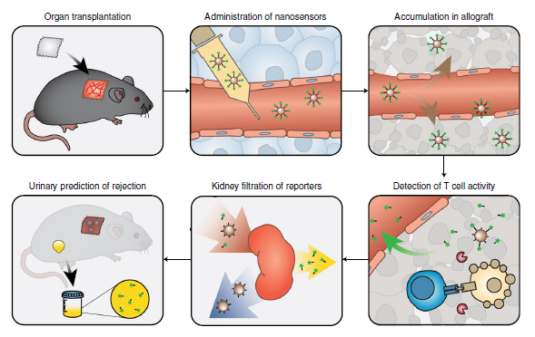
Method 2: Trial
Notes:
GzmB activity nanosensors are intravenously administered and accumulate in allograft tissues. During onset of acute cellular rejection, GzmB secreted
by alloreactive CD8+ T cells cleaves peptide substrates on the surface of the nanosensors, triggering release of fluorescent reporters into urine. Urinary
signals are quantified as early-stage biomarkers of acute cellular rejection.

Slide 9
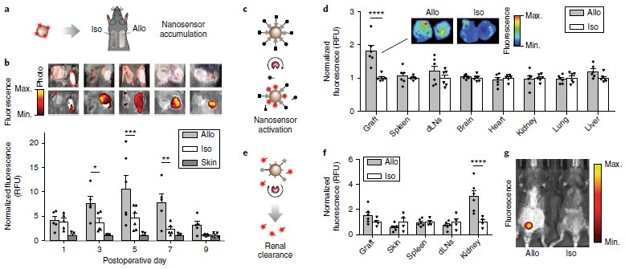
Results
Notes:
a, Mice bearing both isograft (Iso) and allograft (Allo) tissues are
dosed with surface-labelled nanosensors for allograft accumulation and biodistribution studies.
b, Top: photographs of mice bearing dual skin grafts and
the corresponding near-infrared (NIR) fluorescent images. Bottom: quantified fluorescent intensities of excised skin grafts n = 5 for PODs 1, 3, 7, 9 and n = 6 for POD 5). Fluorescent signals
from different days were normalized by signals from healthy skin.
C, A schematic of an NIR activatable probe that is conjugated with GzmB substrates containing internal fluorophores and terminal quenchers. After cleavage, the quencher (“löscher”) is liberated to allow
the nanoparticle to fluoresce.
d, Fluorescence of major organs harvested from allograft and isograft mice dosed with the NIR activatable probe. Fluorescent signals were normalized by signals from isograft
mice. Inset: NIR fluorescent image of representative excised skin grafts.
e, Mice bearing either skin allograft or isograft are dosed with activity nanosensors with terminal fluorophores, which can trigger a urine pharmacokinetic switch upon activation by GzmB
during alloreactive T cell killing.
f, Fluorescence of tissue homogenates from allograft and isograft mice after administration of activity nanosensors Fluorescent signals were normalized by signals from isograft mice.
g, Whole-body NIR fluorescent image after administration of activity nanosensors showing fluorescent signals from the bladders of allograft-bearing mice. This experiment was repeated independently 3 times with
similar results.

Slide 10
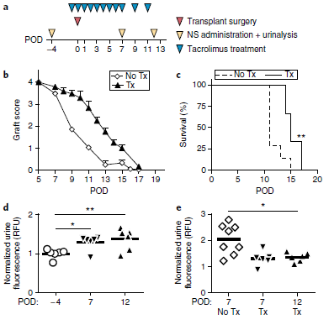
Results
Notes:
Fig. 6 | Urinary prediction of allograft rejection under subtherapeutic
immunosuppression.
A, Timeline of experimental procedures.
b, Skin graft scores quantifying allograft quality in mice given subtherapeutic doses of
tacrolimus (n = 6) and untreated mice (n = 8).
c, Kaplan–Meier survival analysis comparing cohorts of
treated (n = 6) and untreated mice (n = 8)
d, Quantified urine fluorescence after administration of nanosensors to
tacrolimus-treated allograft-bearing mice before (POD −4) and after
transplantation (PODs 7 and 12). Urine signals were quantified as percent injected dose before being normalized
by pre-transplant signals.
e, Fold increase in urine signals relative to pre-transplant signals in tacrolimus-treated (PODs 7 and 12, n = 6) and
untreated (POD 7, n = 8) allograft
Daily treatment with high-dose tacrolimus (2 mg kg−1)
improved skin allograft outcome as quantified by both graft scores
and survival curves, but was subtherapeutic and did not prevent
eventual graft loss due to MHC-mismatched donor and recipient
mice (Fig. 6b,c)
These results showed that our urine measurements are
sensitive to GzmB activity under subtherapeutic immunosuppression
and provide an early indicator of eventual graft failure.

Slide 11
Discussion
GzmB activity nanosensors to sense CD8+ T cell killing
based on local cleavage, remote detection of cleaved reporters enriched in urine
GzmB activity nanosensor accumulate and activate in allograft tissue, cleared efficiently in urine
High specifity and sensitivity
family of activity sensors against a panel of proteases can be created

Slide 12
Critique
Induced rejection (MHC-incomp., Tac-Dosage)
Kinetic of nanosensor not clear (lost of activity) due to endpoint of 2 weeks
Tested in skin allograft (model)
Feasability in clinical setting not clear
Cost-effectivenes not clear
Notes:
Punkt 1: obvious «massive induction» of GzmB

