Slide 1
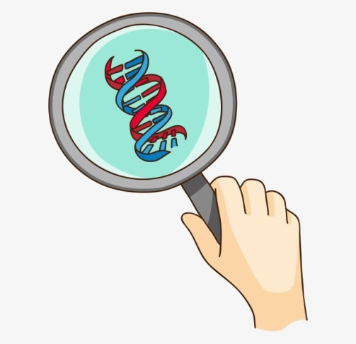
Molecular phenomics and metagenomics of hepatic steatosis in non-diabetic obese women
Hoyles L, Fernández-Real JM, Federici M, et al.
Nature Medicine 2018;24:1070-1080
Journal club: October 18, 2018
Patcharamon Seubnooch
PhD student

Slide 2
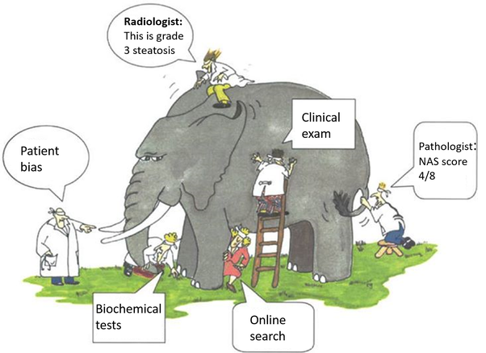
What is the mechanism of hepatic steatosis?
Systems Biology does not investigate individual cellular components at a time, but the behaviour and relationships of all of the elements in a particular biological system while it is functioning.
Systems Biology
It’s an elephant

Slide 3
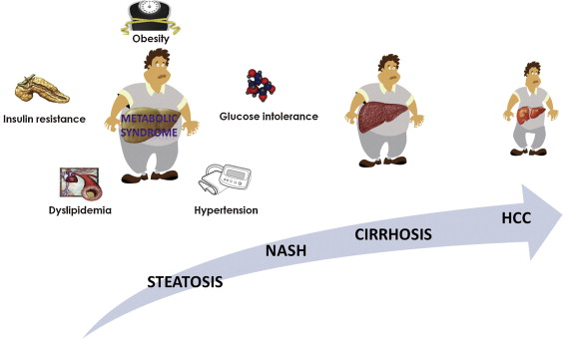
Hepatic steatosis in non-diabetic obese women
Hepatic steatosis is a multifactorial condition that is often observed in obese patients and is a prelude to non-alcoholic fatty liver disease (NAFLD).
The physiological mechanisms of Hepatic steatosis remain poorly understood.
This research characterize the physiological mechanisms that are responsible for the integrated interactions between signals from the gut metagenome and the host molecular phenome of hepatic steatosis.
Tian Y, et al. Seminars in Cancer Biology (2013)
Notes:
Hepatic steatosis is a multifactorial condition that is often observed in obese patients and is a prelude to NAFLD may progress to NASH, cirrhosis and finally HCC.
Hepatic steatosis is a shared mechanism for the development of type 2 diabetes and cardiovascular disorders in humans, but the physiological mechanisms behind this interplay remain poorly understood.
This research take advantage of the advances in high-throughput sequencing and phenotyping technologies to characterize in humans the physiological mechanisms that are responsible for the integrated interactions between signals from the gut metagenome and the host molecular phenome of hepatic steatosis.

Slide 4
Phenomics and Metagenomics
Human body contains same amount of bacteria than human cells
Sender et al. bioRxiv (2016)
Genomics
DNA
Transcriptomics
mRNA
Phenotype
Microbiome
Bacterial DNA
Metabolomics
Metabolites
Modified from: Handout of High troughput sequencing, Ursula Amstutz (2018)
Notes:
Moreover, this study introduce a unique integrative multi-omics and precision medicine approach combining shotgun metagenomics, liver transcriptomics, metabolomics in plasma and urine and clinical phenotyping to clarify the molecular mechanisms of steatosis in non-diabetic obese women.
Recently, gut microbiota emerged as a pivotal transducer of environmental influences to exert protective or detrimental effects on several host tissues and systems, including regulation of intermediary metabolism, liver function and cardiovascular disorders, either directly via translocation or indirectly through microbial metabolism or function in metabolic disorders.
‘ OMICS’ TECHNOLOGIES. Omics refers to the collective technologies used to explore the roles, relationships, and actions of the various types of molecules that make up the cells of an organism. These technologies include: Genomics, “the study of genes and their function” (Human Genome Project (HGP), 2003) Proteomics, the study of proteins.

Slide 5
What is Metagenomics?
“…is the study of genetic material recovered directly from environmental samples.” wikipedia
aka environmental genomics, ecogenomics or community genomics
Modified from: Handout of High troughput sequencing, Ursula Amstutz (2018)
Notes:
Metagenomics is the study of genetic material recovered directly from environmental samples and also known as environmental genomics, ecogenomics or community genomics.
Traditionally in Microbiome what they try to do is they will isolate the specific strain, purify it, then sequencing to genome and search against database.

Slide 6
Recruitment of patients and processing of samples
Design: cohort study (2 unique and independent cohorts of women)
n = 61
Inclusion criteria
All subjects were of Caucasian origin.
The subjects reported a stable body weight 3 months preceding the study.
They were not given a liquid diet before surgery.
They were free of any infections, including the use of antibiotics, 1 month before surgery and had no systemic disease.
n = 44
105 morbidly obese woman who elected for bariatric surgery
Fecal metagenomics
Exclusion criteria
Subjects with a known medical history of
diabetes or self-reported use of hypoglycemic agents
presence of liver disease, specifically Hepatitis B, hepatitis C virus infection and tumor disease
thyroid dysfunction
Autoimmune hepatitis
The subjects were alcohol consumption of > 20 g/day
To avoid iron overload, serum ferritin was below 200 ng ml^{–1} in all subjects.
Alpha-1 antitrypsin deficiency was excluded by anamnestic data and clinical evidence.
Drug-induced liver injury was excluded using a drug questionnaire.
Stool (gut microbiome)
Molecular phenomics
Plasma and urine metabolomes
Liver transcriptomes
Clinical phenotypes
(age, cohort, BMI, and the other clinical variables)
multivariate model integrating metagenomic, transcriptomic and metabolomic information
Hepatic steatosis signatures in non-diabetic obese women
Notes:
To characterize the hepatic steatosis phenome, this study established two unique and independent cohorts of women from Italy and Spain who elected for bariatric surgery.
Inclusion and exclusion criteria was shown in this slide
In this study, clinical phenotypes were complemented by fecal metagenomics and molecular phenomics, which is plasma and urine metabolomes and liver transcriptomes.
To study Fecal metagenomics and Molecular phenomics, stool and biofluid samples from all of the subjects were obtained during the week before elective gastric bypass surgery, during which the liver biopsy was sampled.

Slide 7
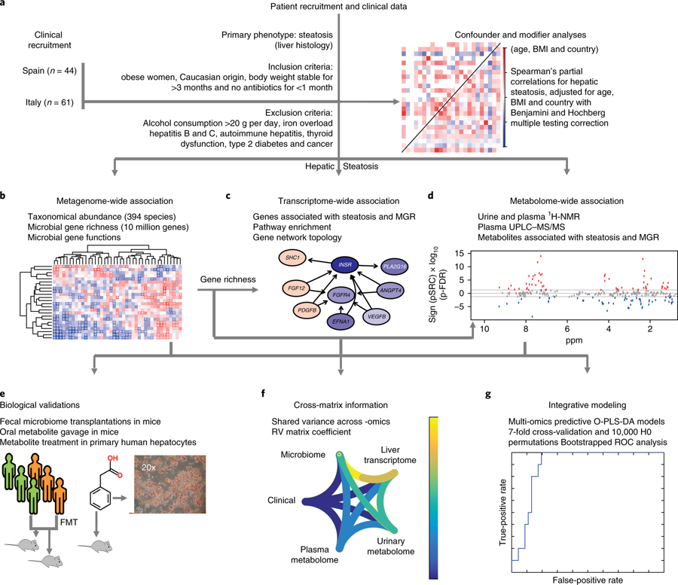
The integration of clinical, molecular phenomics and metagenomic information and biological validations

Slide 8
The integration of clinical, molecular phenomics and metagenomic information and biological validations
Notes:
Before starting all experiment, Linear modeling was used to identifier confounders and modifiers within the clinical data.

Slide 9
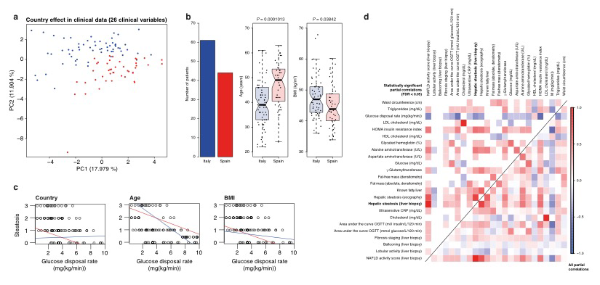
Determination of distinction between confounders and modifiers, for inclusion of confounders in partial correlations (n = 105)
Age, cohort and body mass index (BMI) as confounders
These three confounders were taken into account in all subsequent partial Spearman’s rank-based correlation (pSRC) patterns across clinical variables.
a, Principal component analysis showing the effect of country of recruitment on clinical data. Red, Spain; blue, Italy.
b, Boxplots (median, with interquartile range and 1.5 times interquartile range) showing that based on linear modeling BMI, country and age were found to be confounders. Significant differences between the data for the Spanish (in red) and Italian (in blue) cohorts were determined using Student’s t test (two-sided, p < 0.05).
c, Example of identification of modifiers rather than confounders, using glucose disposal rate (M) (mg/(kg/min)). Any change in slope of the line between both models indicates that M (mg/(kg/min)) is a mediator not a confounder and can, therefore, not be corrected for in partial correlations.
d, Heatmap of partial Spearman rank-based correlations between clinical parameters adjusted for age, BMI and country.
Notes:
As show in this slide they found that age, cohort and BMI were confounders, whereas all other clinical variables were mediators or had no effect on generalized linear models.
These three confounders were taken into account in all subsequent partial Spearman’s rank-based correlation (pSRC) patterns across clinical variables.

Slide 10
The integration of clinical, molecular phenomics and metagenomic information and biological validations
Notes:
To evaluate Metagenomic signature of hepatic steatosis, they sequenced the patients’ fecal metagenome and data were processed using their in-house pipeline, performing quality control checks, filtering and binning of reads into taxonomic kingdoms.

Slide 11
Metagenomic signatures of hepatic steatosis in obese women
a.
b.
a. Boxplots showing that MGR was significantly anti-correlated with liver steatosis using pSRC, adjusted for age, BMI and sex (two sided, n = 56).
b. Heatmap showing the significant correlation of MGR with clinical data (n = 56, pSRC, two-sided, p-FDR < 0.05 values shown).
For all panels, n = 56, groups as no liver steatosis = 10; liver steatosis 1 = 22; liver steatosis 2 = 14; liver steatosis 3 = 10.
All boxplots are the median with the interquartile range, and the error bars are the 1.5-times interquartile range.
Notes:
Hepatic steatosis is negatively associated with microbial gene richness (MGR) as show in figure a; liver steatosis grade 0 had high microbial gene richness than the other.
The striking association between low MGR and hepatic steatosis is consistent with clinical results. As show in fig b several markers of liver function, as well as with echography-assessed liver steatosis were significantly anti-corrrelated with hepatic steatosis.
including γ -glutamyltransferase, alanine aminotransferase and inflammation,

Slide 12
Metagenomic signatures of hepatic steatosis in obese women
d.
c.
e.
c. Heatmap showing the association of genus-level abundance data with clinical data (n = 56, pSRC, two-sided, + indicates stastistical significance p-FDR < 0.05).
d & e. Boxplots showing prokaryotic taxa that are significantly associated with hepatic steatosis.
Prokaryotic taxa that are significantly anti-correlated with liver steatosis at the phylum and genus levels (n = 56, pSRC, two-sided, p-FDR < 0.05; see Supplementary Table 6 for the exact and the BH-adjusted P values) are shown (d).
Prokaryotic taxa that are significantly correlated with liver steatosis at the phylum and genus levels (n = 56, pSRC, two-sided, p-FDR < 0.05; see Supplementary Table 6 for the exact and the Benjamini-Hochberg (BH)-adjusted P values) are shown (e).
For all panels, n = 56, groups as no liver steatosis = 10; liver steatosis 1 = 22; liver steatosis 2 = 14; liver steatosis 3 = 10.
All boxplots are the median with the interquartile range, and the error bars are the 1.5-times interquartile range.
Notes:
From the data sequencing (Supple F2), the majority of faecal DNA belonged to prokaryotes (archaea and bacteria).
Then to determine whether specific microorganisms were responsible for this correlation, they assessed the abundance of prokaryotes within the metagenomes.
(fig d & e) Several taxa were significantly associated with liver steatosis (both anti-correlated and correlated)
and other related clinical parameters as show in fig C

Slide 13
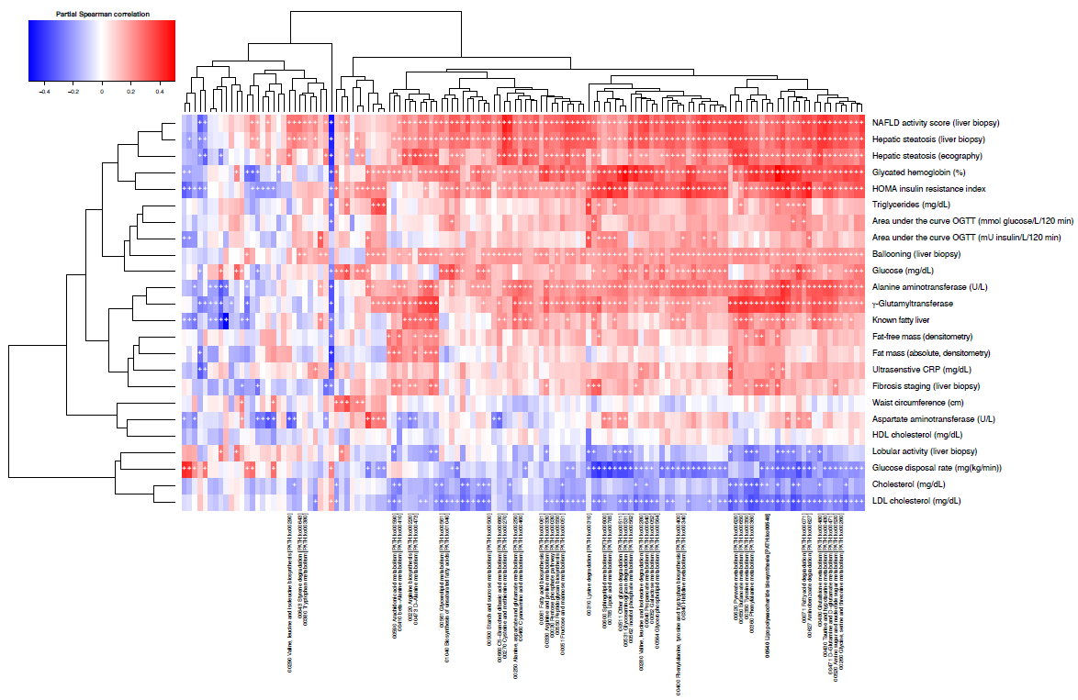
Heatmaps showing partial Spearman rank-based correlation of metagenome-derived KEGG pathway data with clinical data for the 56 patients whose metagenomes were analyzed.
Notes:
Then they investigated the associations between microbial function, by mapping their microbial gene catalog onto KEGG modules, and clinical phenotypes, thus revealing positive associations of hepatic steatosis with microbial carbohydrate, lipid and amino acid metabolism
There are a lot of metabolites which significantly correlated with liver steatosis and clinical results
However, there are 2 important metabolites which are LPS and peptidoglycan biosynthesis, which as observed in rodents will show in the next experiment
These data indicate that a change in microbial metabolism may contribute to liver health in obese women.

Slide 14
The integration of clinical, molecular phenomics and metagenomic information and biological validations

Slide 15
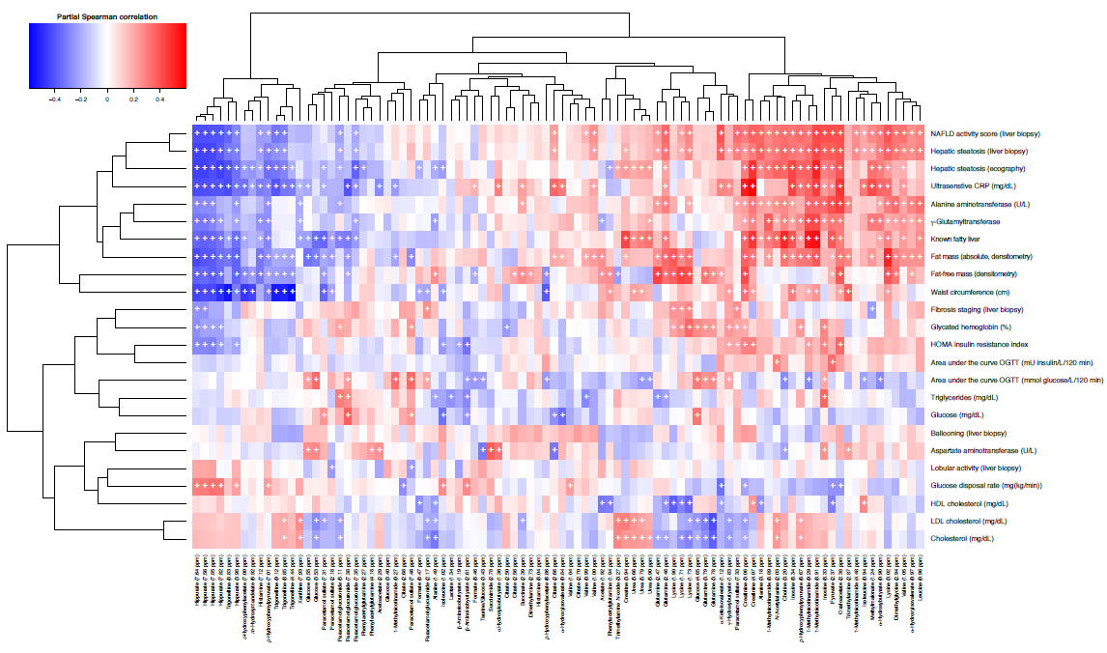
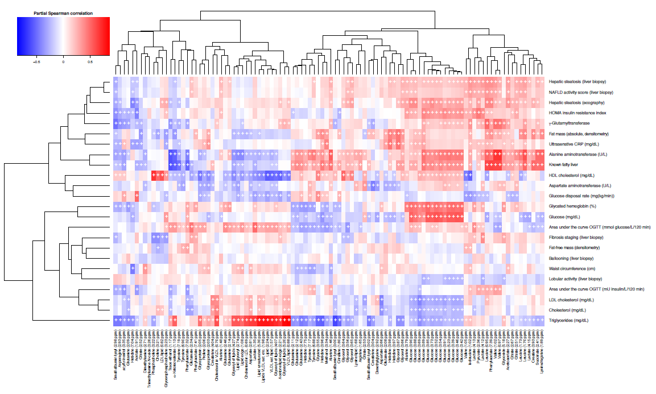
Urine metabolites
Metabolic profiling of urine and plasma by ¹H-NMR spectroscopy
Plasma metabolites
124 metabolite signals in the urine and 80 in the plasma that correlated with hepatic steatosis and associated clinical traits
Notes:
They found 124 metabolites in the urine and 80 metabolites in the plasma that correlated with hepatic steatosis and associated clinical results.

Slide 16
The plasma and urinary metabolites that are most significantly partially correlated with liver steatosis
Plasma metabolites
Urine metabolites
Notes:
This figure show the majority association of liver steatosis-associated metabolites in plasma and urine were also associated with low microbial gene richness.
Among the top liver steatosis metabolites also associated with low MGR, they observed a significant correlation with branched-chain amino acid (BCAA) levels (leucine, valine isoleucine) in the plasma and a significant increase in levels in the urine consistent with reports in obese patients.
These results suggest the existence of a metabolic phenotype associated with hepatic steatosis and low MGR, pinpointing elevated branched-chain aminoacid (BCAA), aromatic amino acid (AAA) and microbial metabolite levels coupled to a potential imbalance in hepatic oxidation and conjugation of those microbial substrates.

Slide 17
The integration of clinical, molecular phenomics and metagenomic information and biological validations
Notes:
To clarify more about the hepatic molecular mechanisms associated with the gut microbiome, they study phenome by profiling hepatic transcriptomes on liver biopsy from the same set of patients.

Slide 18
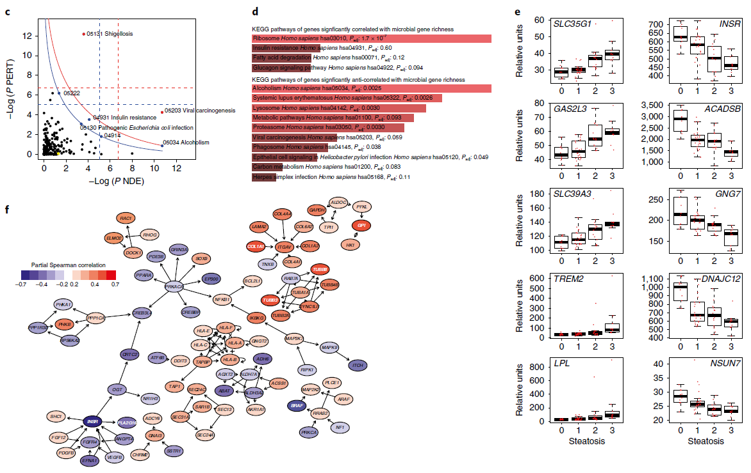
Association of transcriptomic data with liver steatosis and MGR
‘NAFLD – Homo sapiens (human)
LPL: encodes lipoprotein lipase
ACADSB: encodes short/branched-chain acyl-CoA dehydrogenase
INSR: encodes the insulin receptor
Notes:
A hepatic signaling pathway impact analysis (SPIA) including the 2,277 genes that intersected the liver steatosis and MGR-associated genes were generated.
Fig C show 2,277 genes that are significantly associated with liver steatosis and MGR.
The yellow node represents the KEGG pathway of ‘NAFLD – Homo sapiens (human) gene.
Enrichment analysis of the hepatic genes significantly correlated and anti-correlated with MGR is shown in fig d.
Boxplots showing the ten hepatic genes that are most significantly correlated and anti-correlated with liver steatosis.
LPL (which encodes lipoprotein lipase) was among the most correlated with hepatic steatosis.
Whereas acyl-CoA dehydrogenase short/branched chain: ACADSB (which encodes short/branched-chain acyl-CoA dehydrogenase) and Insulin Receptor: INSR (which encodes the insulin receptor) were the most anti-correlated, suggesting a molecular basis for the observation that individuals with low MGR have a reduced capacity to respond to insulin.
Moreover to complemented they analyses of the hepatic transcriptome by assessing the topology of a directional network made of 2,277 genes that were significantly associated with liver steatosis and low MGR mapped onto KEGG pathways involved in liver disease as shown in fig F

Slide 19
The integration of clinical, molecular phenomics and metagenomic information and biological validations
Notes:
Overall, hepatic gene expression is relate with the metabolic signature obtained in the plasma and urine, showing elevated branched-chain amino acid levels associated with low MGR, liver steatosis and insulin resistance, highlighting the interconnection among these three parameters.
Then they tested whether fecal microbial communities from donors with hepatic steatosis (grade 3) could trigger steatosis molecular mechanisms to recipient mice when compared with samples from donors without hepatic steatosis (grade 0)

Slide 20
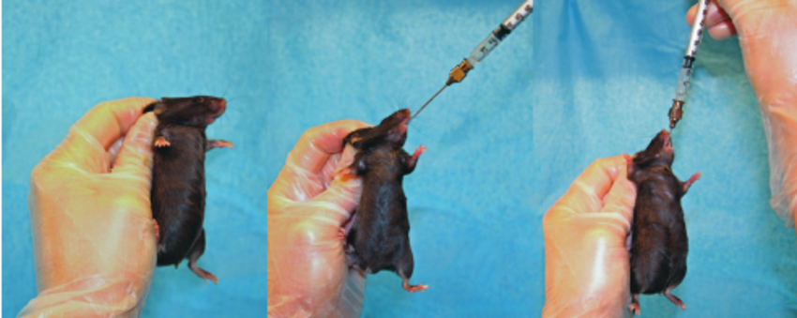
Transfer of steatotic and metabolic phenotypes to mice through FMT of material from patients with (n = 3) and without (n = 3) liver steatosis grade 3
The mice were then gavaged once a day for four consecutive days with the fecal matter suspended in the buffer
Notes:
After a short antibiotic treatment and washout period, they gave four consecutive daily fecal microbiota transplantations (FMTs).
Then the recipient mice were fed a chow diet for 2 weeks before the end of points.
The results showed in a moderate but rapid accumulation of hepatic triglycerides
They also observed an increase in Fabp4 expression and plasma valine concentration compared with mice that received samples from patients without liver steatosis, showing the general effect of the steatosis-associated microbiota from human donors on mouse liver lipid accumulation.

Slide 21
hepatic triglyceride content
Fabp4
plasma valine level
Notes:
By permutation testing sevenfold cross-validated orthogonal partial least squares models using the donor human microbiome composition, they could successfully predict recipient mouse phenome responses, especially for steatosis, hepatic triglyceride content, Fabp4 and plasma valine level, the statistical robustness of the prediction between human donor microbiomes and recipient mouse phenome.
Then they derived significant associations between the donor microbiota composition and the mouse phenome, showing that the steatosis-associated microbiota influences multiple patterns of association with hepatic triglycerides, circulating branched-chain amino acid BCAAs and TMAO (trimethylamine N-oxide)
Microbiome-associated factors involve, for instance, bacterial lipopolysaccharide (LPS) or methylamines, such as trimethylamine (TMA) and TMA N-oxide (TMAO), playing a part in the development of insulin resistance
and atherosclerosis

Slide 22
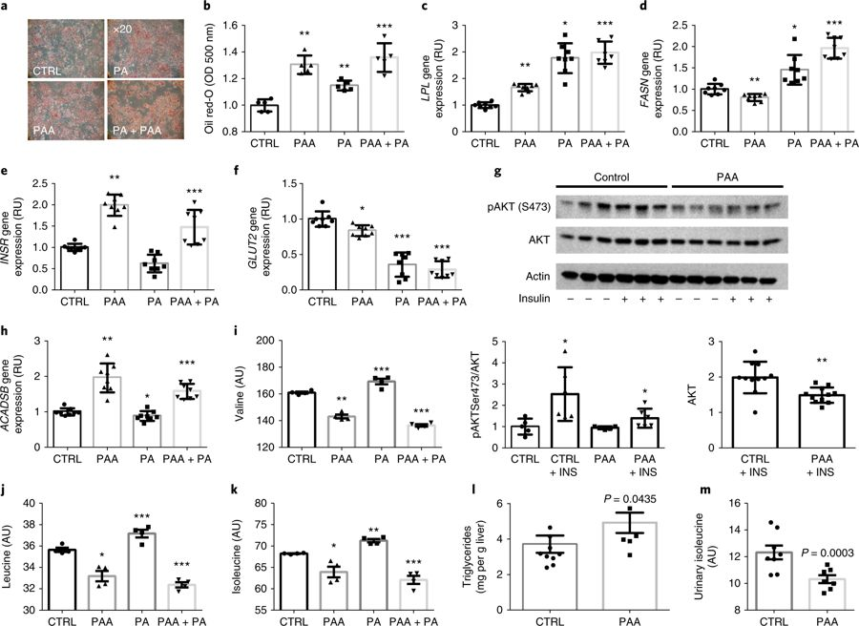
Notes:
To highlight the potential of novel microbial compounds to directly affect the hepatic steatosis phenome, they selected PAA (phenylacetic acid) due to it is the strongest microbial metabolite associated with steatosis in the metabolome-wide association study models (in metabolomics part).
The results show that PAA had the effect on lipid accumulation as show in fig b the expression of genes involved in steatosis as well as branched-chain amino acid metabolism and consumption as show in fig c-k.
Moreover, they treated mice with PAA for 2 weeks and confirmed the increase in hepatic triglyceride levels and the decrease in excreted isoleucine (Fig. 5l,m).
These results suggest that PAA, as one of the top hepatic steatosis-associated microbial metabolites, significantly increases hepatic branched-chain amino acid utilization and hepatic lipid accumulation.
PAA induces the expression of lipid metabolism genes (LPL and FASN; Fig. 5c,d).
PAA induced INSR expression contrary to PA and participated in the reduction of GLUT2 expression (Fig. 5e,f).
They investigated AKT phosphorylation, which was significantly lowered by PAA, suggesting that PAA reduces the response to insulin (Fig. 5g).
PAA increased ACADSB expression (Fig. 5h) and resulted in an increased utilization of BCAA from the cell medium (Fig. 5i–k).
microbiota-produced metabolite that was most strongly associated
with steatosis, namely, phenylacetic acid (PAA),

Slide 23
The integration of clinical, molecular phenomics and metagenomic information and biological validations
Notes:
Finally, they quantified the crosstalk among gut microbiome, clinical phenotypes, liver transcriptome and urine and plasma metabolomes by estimating the proportion of shared variation among the different tables through RV coefficients.

Slide 24
Integrative data crosstalk and steatosis signatures
Notes:
A high proportion of information (79–97%) was shared between matching data sets.
This statistical crosstalk analysis suggests a strong similarity between metagenomic and phenomic data.
Moreover, they built a multivariate model integrating metagenomic, transcriptomic and metabolomic information in fig b-d.
Taken together, these predictive models further support the idea that these molecular signatures used to generate hypotheses are robust and ultimately suggest that the link tethering the microbiome to hepatic steatosis is also robust.
the weakest (79.44%) being between urinary metabolome and clinical parameters.
The metagenomic data shared 92–93% similarity with clinical parameters, liver transcriptome and plasma metabolome, whereas they only shared 74.68% with the urinary metabolome.

Slide 25
Conclusion
Molecular networks between the gut microbiome and the hepatic steatosis phenome in obese woman
Hepatic steatosis is negatively associated with MGR and that the microbiome contributes to the steatosis phenome in clinical and preclinical results.
An increased gut microbial amino acid metabolism in steatotic subjects that has a profound effect on their liver transcriptome, biofluid metabolomes and liver fat accumulation, eventually leading to fatty liver.
The bioinformatic analysis of metagenomic sequences combined with metabolomic data suggested a direct role for microbial degradation of AAAs into PAA in patients with steatosis.
Notes:
in aromatic amino acid (AAA)
phenylacetic acid (PAA),

Slide 26
Thank you for your attention

