Slide 1
Changes in Ascitic Fluid Polymorphonuclear Cell Counts Impact Mortality in Patients With Spontaneous Bacterial Peritonitis S.SaffoU.K.ToP.P.SantoiemmaM.LauritoL.HaqueA.RabieeE.C.VernaM.P.AngaroneG.Garcia-Tsao
Henry Wichter: Journal Club 12.08.2021

Slide 2
BackGround
“Spontaneous bacterial peritonitis (SBP) is a feared complication of ascites that affects 10%–30% of hospitalized patients with cirrhosis with an associated mortality rate of approximately 20%”1, 2, 3
“Approximately half the episodes of SBP are present at the time of hospital admission and the remainder are acquired during hospitalization” 1
“A diagnostic paracentesis should be performed on hospital admission in all cirrhotic patients with ascites to investigate the presence of SBP, even in patients admitted for reasons other than ascites” 1
“There is significant interest in identifying factors that can reliably predict mortality among individuals with SBP”

Slide 3
Research Questions:
What ways are there to reliably predict mortality among patients with SBP?
Which diagnostic tests are there to quickly evaluate the need for intesified treatment?
Which factors are associated with an increased mortality of patients with SBP?

Slide 4
Risk Factors for increased mortality in SBP (30-day and in-hospital mortality)
Age
Nosocomial Infection
High MELD-Na Scores
Positive ascitic fluid cultures
Initial use of broad-spectrum Antibiotics

Slide 5
PMN Cell count in ascitic fluid was also shown to predict in-hospital mortality
Scientific Question:
Do changes of PMN cell count have an impact on mortality in patients with Spontanous bacterial peritonitis?
Hypothesis: Patients without a marked decrease in ascitic fluid PMN cell count after 2 days have increased odds for death after adjusting for liver desease severity and other relevant factors.

Slide 6
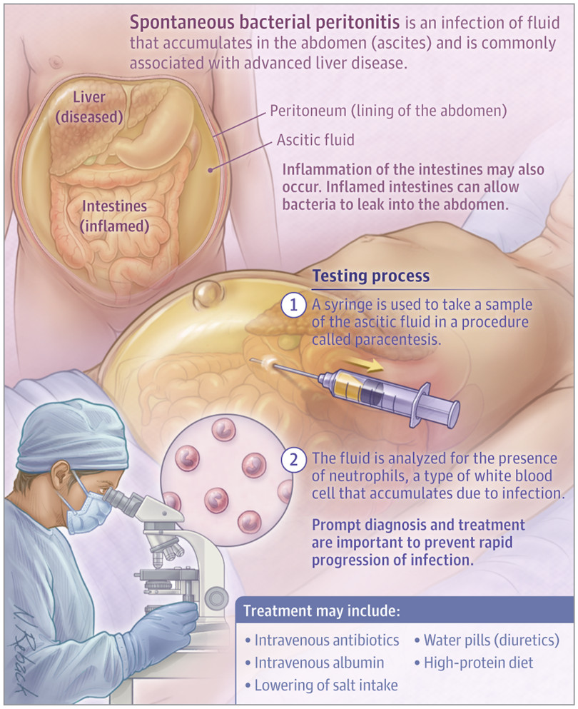
The idea:
After initiation of treatment a follow-up paracenteses is performed in order to reevaluate the change in PMN cell count.
The question: Does a decrease in PMN cell count impact the mortality of patients with cirrhosis who were hospitalized and received a diagnosis of SBP based on an initial ascetic PMN cell count of ≥250 cells/microliter.
Source: Spontaneous Bacterial Peritonitis | Infectious Diseases | JAMA | JAMA Network

Slide 7
Study design
Retrospective, multicentric, non randomized, controlled study.
Medical Records at 3 tertiary centers were queried for eligible patients.
Centers: 1. Yale-New Haven Hospital, 2. New York-Presbyterian Hospital/Columbia University , 3. Northwestern Memorial Hospital
Time period: 2006- 2016
Optimal cut-off for change in PMN count was set to 2 days
Analysis stratified based on institution
Primary Outcome: In-hospital mortality

Slide 8
Patient population:
Inclusion criteria:
Hospitalised adults with cirrhosis and: 1. Diagnosis of SBP based on an ascitic fluid PMN cell count ≥ 250 cells/microliter. 2. follow-up paracenteses after 2 days of antimicrobial therapy.
Exclusion criteria:
Patients with suspected secondary bacterial peritonitis.
Patients who were treated at ICU at the time of SBP diagnosis.

Slide 9
Patient Characteristics:
Included patients: 426
With markers of advanced cirrhosis ( median MELD-Na: 28) and organ dysfunction (median Creatinine 1.5)
426 Patients
40% Alcohol- related cirrhosis
15% had diagnosis of SBP before
15% Ascitic fluid cultures positive
42% initially received broad-spectrum antibiotics

Slide 10
Yale | Columbia | Northwestern | Combined
n, median | IQR | % | n, median | IQR | % | n, median | IQR | % | n, median | IQR | %
Demographics
Number | 96 |  |  | 115 |  |  | 215 |  |  | 426
Age, y | 54 | 13 |  | 57 | 13 |  | 57 | 14 |  | 57 | 14
Sex (male) | 75 |  | 78 | 79 |  | 69 | 135 |  | 63 | 289 |  | 68
Nosocomial | 28 |  | 29 | 28 |  | 24 | 33 |  | 15 | 89 |  | 21
Length of stay | 15 | 21 |  | 13 | 14 |  | 9 | 9 |  | 10 | 13

Slide 11
Cut-off Value: PMN Score
An association between changes in PMN cell count after 2 days and in-hospital mortality was observed:
Decrease in PMN cell count, % | Number | Survival, %
≤0 | 71 | 63.4
0–20 | 16 | 62.5
20–40 | 32 | 71.9
40–60 | 42 | 73.8
60–80 | 78 | 76.9
>80 | 187 | 90.4
A cutoff value of approximately 80% reduction in PMN cell count was most predictive of survival

Slide 12
Logistic regression analysis was performed to assess impact of relevant factors like:
Variable | aOR | 95% CI | P value
Nosocomial infection | 1.56 | 0.83–2.86 | .16
Age, y | 1.04 | 1.01–1.07 | < .01
WBC, 10⁹ cells/L | 1.02 | 0.99–1.05 | .18
MELD-Na | 1.11 | 1.07–1.15 | < .001
80% reduction in PMN cells | 0.32 | 0.17–0.58 | < .001
Positive ascitic fluid cultures | 2.34 | 1.35–4.06 | < .01
Broad-spectrum antibiotics | 1.82 | 1.03–3.21 | .04
Covariates with P < .10 in univariable logistic regression analysis were included.
All factors associated with in-hospital mortality in univariable logistic regression analysis were subsequently included in a multivariable model together with a cutoff value of approximately 80% reduction in PMN cell count which most predictive of survival.

Slide 13
Multivariable Analysis
A reduction in PMN cell count >80% was associated with improved survival (adjusted odds ratio, 0.32; 95% confidence interval, 0.17–0.58; P < .001), whereas increasing age, higher MELD-Na scores, positive ascitic fluid cultures, and broad-spectrum antibiotics were associated with increased mortality
The combination of MELD-Na scores and 2-day changes in PMN cell count using a cutoff of 80% accurately risk-stratified patients in our cohort

Slide 14
Risk stratification:
7 times lower
Mortality Rate: 43%
Mortality Rate: <6%
Intermediate-risk patients (MELD-Na Score ≤30 without reduction in PMN cell count >80%) had a mortality rate of 17-20%

Slide 15
Discussion:
The analysis suggests that, among predominantly noncritically-ill hospitalized patients with SBP:
-those with older age
-higher MELD-Na scores
-positive ascitic fluid cultures
-initial broad-spectrum antibiotic use
have increased in-hospital mortality!
Changes in the PMN cell count over the first 2 days also carry important prognostic value.
-Patients who experience reductions >80% have improved survival!

Slide 16
Clinical implication:
Hospitalised patients should be risk-stratified based on their MELD-Na scores and the interval change in PMN cell counts.
For low-risk patients prognosis is favourable and standart treatment can be maintained.
For intermediate and high-risk patients, further studies are required to determine wether changes in e.g. antimicrobiobial therapy or other treatments improve the outcome.

Slide 17
Limitations:
Cons
Pros
Multicenter design
Large sample size
Variablity in clinical pratice within the participating centers.
Depending on paracentesis findings after 2 days in patients with SBP after treatment initiation.
Findings that are immidiatly available at the time of diagnosis would be optimal.

Slide 18
Questions not answered:
Why was a logistical regression used instead of a Cox Regression? Time factor could have been evaluated as well?
How many Patients did actually meet the Primary Endpoint: in-hospital mortality?
Stratified for etiology of Cirrhosis?
Why did they use a 2-day interval for the second paracenteses? Maybe another interval would have been more predictive.
No control group for the cutt-off value of 80% -> self fulfilling prophicy?
Is the initial cut-off for diagnosis of SBM via PMN cell counts >250/microlitre predictive and was the 80% cut-off stratified, when there were higher initial values?

Slide 19
Literature
1. Rimola A, et al. J Hepatol 2000;32:142-53.
2. Follo A, et al. Hepatology 1994;20:1495-501.
3. Devani K, et al. J Clin Gastroenterol 2019;53:e68-e74.
4. Goel A, et al. J Clin Gastroenterol 2017;51:278-284.
5. Santoiemma PP, et al. PLoS One 2020;15:e0239470.
6. Akriviadis EA, et al. Gastroenterology 1990;98:127-33.
7. Runyon BA, et al. Arch Intern Med 1986;146:1563-5.
8. Runyon BA; AASLD Practice Guidelines Committee. Hepatology 2009;49:2087-107.

Slide 20
Thank you!

